Slide 1
Clinical Management
Module 4 (b)
Risks and Side Effects

Slide 2
Overview
GI effects
ARV resistance
Renal
HBV management
BMD
Risk compensation
GI effects
ARV resistance
Renal
HBV management
BMD
Risk compensation

Slide 3
GI effects
ARV resistance
Renal
HBV management
BMD
Risk compensation
GI effects
ARV resistance
Renal
HBV management
BMD
Risk compensation

Slide 4
Resistance
Resistance has occurred rarely when PrEP initiated during acute HIV infection
  M184V
Prevent by not initiating/re-initiating PrEP during acute HIV infection
HIV testing
  3-monthly
  symptoms viral illness
  before resuming PrEP
  accompanied by HIV exposure assessment, symptom screen and targeted examination
Notes:
At the time of writing the guideline, the only HIV resistance documented to date amongst PrEP users has been amongst clients who initiated PrEP when they were already HIV infected (during acute HIV infection). Predictably, the FTC resistance mutation M184V was the first to occur. To prevent the risks of developing ARV resistance, clinicians must focus on not commencing or reinitiating PrEP after a break, during acute HIV infection.
HIV testing should be done 3-monthly, and should be accompanied by an HIV exposure assessment, symptom screen and a targeted examination to exclude acute HIV infection. HIV testing should also be repeated whenever symptoms of a viral illness are present. Clinicians should advise clients on the need for an HIV test before resuming PrEP if it was stopped, particularly if they have potentially been exposed to HIV during this period.

Slide 5
PrEP and ARV resistance
Resistance from PrEP was very rare, with only a small number who had acute infection at the time they were started on PrEP
 | # of HIV seroconverters assigned PrEP with HIV resistance
 | HIV infected after enrollment | Seronegative acute HIV infection at enrollment
6 studies* | 5/533 [6/533; 2%] | 6/44 [8/44; 18%]
* Incl Partners PrEP, iPrEx, TDF2
Additional HIV infections showed resistance unrelated to PrEP
Resistance = K65R (TDF) or M184V/I (FTC) mutations
Fonner VA, et al. AIDS 2016

Slide 6
Drug resistance
 | Individuals Uninfected at Baseline Who Acquired HIV-1 on Study, n |  | Unrecognized Baseline Infections, n
Study | HIV Infections | Resistant to FTC or TDF | HIV Infections | Resistant to FTC or TDF
iPrEx | 131 (48 on TRUVADA, 83 on placebo) | 0 | 10 (2 on TRUVADA, 8 on placebo) | 2 on TRUVADA (M184V/I); 1 on placebo (M184V/I)
Partners PrEP | 63 (12 on TRUVADA, 51 on placebo) | 0 | 9 (3 on TRUVADA, 6 on placebo) | 1 on TRUVADA (M184V)
Resistance development to FTC or TDF was more likely to occur when TRUVADA for PrEP was given during unrecognized/acute infection
US Public Health Services. http://www.cdc.gov/hiv/pdf/guidelines/PrEPguidelines2014.pdf. 2014.

Slide 7
Resistance: Conclusions
Risk of TDF or FTC resistance during use of PrEP was low
Meta-analysis: randomisation to PrEP higher risk of resistance compared with placebo among those acutely HIV-infected when starting PrEP (FTC > TDF)
  Consistent with Partner’s PrEP Study Continuation
Risk of drug resistance with PrEP has to be weighed with overall benefits
  If PrEP withheld, more HIV infections would have occurred, which would
  Require life-long therapy with an annual risk of drug resistance 5% - 20%
Levels of resistance with PrEP expected to be less than if HIV is left unchecked (mathematical modelling)

Slide 8
Infection with multidrug resistant HIV despite use of TDF/FTC for PrEP
Case report of HIV transmission while on FTC/TDF for PrEP
43 y/o MSM (no IDU) on PrEP (TDF/FTC) X 2 years, with high adherence by self report
      Multiple, condomless, anal sexual exposures in 2-4 weeks prior to HIV diagnosis
      Day 0: 4th Gen+, p24+, Western blot-
TDF and FTC levels:
  TDF and FTC detected at Day 0 (by LC-MS)
  Based on DBS data, TFV-DP levels were consistent with being adherent to PrEP > 8 weeks
Transmission of multidrug, class-resistant HIV
  4 TAMs, M184V, phenotypic resistance to INSTI EVG (FC >100x)
  Clade B, CCR5-tropic
Resistance test results
Class | Mutation | Resistance Analysis (est. IC50 FC)
NRTI | 41L, 67G, 69D, 70R, 184V, 215E | ABC ↓ 1.9x 3TC resistant FTC resistant TDF ↓ 1.3x
NNRTI | 181C | NVP resistant
PI | 10I
INSTI | 51Y, 92Q | RAL ↓ 2.7x EVG resistant DTG ↓ 9.6x
First reported case of breakthrough HIV infection with a virus carrying TFV and FTC resistance, in a patient with evidence of long-term adherence to TDF/FTV for PrEP
LC-MS - Liquid Chromatography-Mass Spectroscopy
DBS – Dried Blood Spot
Notes:
A second case was reported at R4P 2016:
Grossman H et al. Newly Acquired HIV-1 Infection with Multi-Drug Resistant (MDR) HIV-1 in a Patient on TDF/FTC-based PrEP. HIV Research for Prevention (HIVR4P) 2016 conference, Chicago, October 2016, abstract OA03.06LB.

Slide 9
GI effects
ARV resistance
Renal
HBV management
BMD
Risk compensation
GI effects
ARV resistance
Renal
HBV management
BMD
Risk compensation

Slide 10
Side effects
Mild: headache, malaise
GI side effects
  Nausea, weight loss
Renal toxicity
  Transient increases in serum creatinine
  Decreased GFR
Decreased BMD
  Less cf HIV-infected individuals on TDF
  No differences in fracture rates
Notes:
Minor side-effects have been relatively common, but mild and self-limiting (approximately 1 in 10 individuals in the first 1–2 months)
Gastrointestinal side-effects
The side-effects related to TDF/FTC FDC use in PrEP trials (nausea, weight loss) were mostly self-limiting mild start-up symptoms (first month), but these may adversely affect persistent PrEP effective use. Supportive counselling and symptomatic treatment (anti-emetics) of these symptoms is often sufficient to assist the user to persist beyond the first month, after which the symptoms tend to subside. This may also be accompanied by mild headache and some malaise. Rates of other GIT symptoms (bloating, abdominal tenderness, flatulence) amongst PrEP trial participants who took TDF/FTC FDC were not significantly different from those who took placebo.
Renal toxicity
Modest, transient increases in serum creatinine have been noted in completed PrEP studies, but these did not persist after stopping PrEP nor recur on rechallenge. Proteinuria, decreasing glomerular filtration rate (GFR) and Fanconi’s syndrome have been described in the setting of ART, and decreased GFR has been described in the setting of PrEP but has not caused clinical harm. Renal function needs to be measured prior to commencement and monitored in clients using PrEP by measuring serum creatinine and calculating the estimated creatinine clearance. These parameters should be measured at baseline, at month 1, month 4 and then annually thereafter. Hypertensives, diabetics and those with existing glomerulonephropathies (if the bene t of PrEP is still deemed to outweigh clinical risk) should be monitored more frequently. TDF/FTC FDC-based PrEP should be avoided in patients who require the use of other nephrotoxic drugs, such as aminoglycosides for the treatment of drug- resistant tuberculosis (TB). Clients with creatinine clearance < 60 mL/min should not be placed on PrEP and, if found during maintenance, PrEP should be discontinued.
Decreased bone mineral density
Decreases in bone mineral density associated with TDF and FTC/TDF FDC have been observed in completed PrEP trials. Decreases were less than those observed in HIV-infected individuals treated with the same drugs, and appeared to stabilise over time. No difference in fracture rates was seen. Recreational drugs (amphetamines and inhalant use) were associated with reductions in bone mineral density in HIV-negative MSM taking TDF, suggesting some synergistic impact.
Other side-effects
Hyperpigmentation may occur as a side-effect to FTC. The clinician should explain that this is not harmful. Lamivudine (3TC) can be substituted but this will increase the pill burden, which may have an impact on effective PrEP use. PrEP studies to date have used either TDF or TDF in combination with FTC, rather than 3TC.

Slide 11
GI effects
ARV resistance
Renal
HBV management
BMD
Risk compensation
GI effects
ARV resistance
Renal
HBV management
BMD
Risk compensation

Slide 12
HBV management
Risk of viral rebound in undiagnosed chronic HBV if PrEP stopped
Screen for HBsAg and HBsAb
HBV vaccination if HBsAg+/HBsAb-
PrEP not contra-indicated in HBV infection
  Require additional LFT monitoring
Check LFT after stopping PrEP in chronic HBV
Notes:
Hepatitis B management
TDF and FTC both have hepatitis B antiviral activity. The potential risk exists that exposure to these antivirals may treat unidentified chronic hepatitis B infection, with a consequent viral (rebound) upon drug withdrawal that can result in severe liver injury. This phenomenon has not been described with PrEP use to date. However, it is recommended that screening for hepatitis B surface antigen and antibodies occurs prior to PrEP commencement.
It is recommended that, if hepatitis B surface antigen (HBsAg) is positive, the client be investigated prior to commencement of short-term PrEP (Table 3). PrEP is not contra-indicated in those with HBV but we recommend that additional liver function monitoring should be performed. PrEP users with persistently elevated or abnormal liver function tests should be referred for assessment. A possible approach to those with chronic hepatitis B infection may be to prescribe long-term TDF/FTC FDC. Liver function tests should be checked after stopping PrEP in those with chronic hepatitis B infection. Users who are negative for both HBsAg and hepatitis B surface antibody (HBsAb) should commence a hepatitis B vaccine schedule. People with chronic hepatitis B infection may choose to continue using TDF and FTC to control their hepatitis, even if they do not require these drugs any longer for the indication of PrEP. Users with a history of injecting drug use should be screened for hepatitis C and, if positive, referred for further care.

Slide 13
The safety of PrEP in the presence of hepatitis B infection
Most studies to date excluded HBV-positive individuals
  Concern about “flares” if stop TDF/FTC
HBV is common in countries that don’t vaccinate
20% of incident infections become chronic
TDF/FTC suppresses HBV and thus acts as treatment

Slide 14
The safety of PrEP in the presence of hepatitis B infection
Substudy of HBV-positive participants in iPrEx
13/2499 (0.5%) chronic HBV
6 were in the group assigned TDF/FTC
0/6 experienced “flares” after stopping PrEP
2 participants had evidence of acute HBV and started PrEP → severe elevated LFTs (as expected in acute infection) which settled and both cleared virus and became immune

Slide 15
Renal safety
Renal safety assessment of 2499 HIV-negative subjects in iPrEx study
A mild, non-progressive decrease in creatinine clearance (Cockcroft-Gault), that was reversible and readily managed with routine monitoring
  Did not vary by race, age, or HTN history
  Affected by NSAID use
    -3.4 mL/min (+NSAID) vs. -0.3 mL/min (no NSAID), P = 0.04
* in 1,137 subjects
Change in creatinine clearance from baseline (mL/min)*
Mean Change in CrCL (mL/min)
 | TVD | Placebo | P-value
Wk 4 | -2.4 | -1.1 | 0.02
At Stop | +0.3 | +1.8 | 0.02
Post-stop | -0.1 | 0.0 | 0.83
Solomon M, et al. AIDS 2014

Slide 16
Decline in eGFR resolves within weeks of discontinuing TDF or TDF/FTC for PrEP
Partners PrEP: Phase 3, randomised trial of daily oral TDF PrEP vs. TDF/FTC PrEP vs. PBO among African HIV-negative men and women (N=4747) with normal baseline renal parameters
  SCr was assessed quarterly while on study medication, and at 2 monthly visits after d/c
  eGFR was calculated using CKD-EPIa
Mean eGFR was 2-3 mL/min lower on PrEP vs. PBO (P<0.01) at first post-study drug visit
>96% of participants had >75% eGFR reversion to baseline levels by 8 weeks of study drug discontinuation
Mean eGFR at the last on-study and
first post-study drug visit
TDF
FTC/TDF
Placebo
135
n
1271
1308
1345
130
Mean eGFR (mL/min/1.73m²)
125
120
Last on-study
drug visit
First post-study
drug visitª
ª Chronic Kidney Disease Epidemiology Collaboration Equation.
^{b} Median time from the last on-study drug visit to the first post-study drug visit was 4 weeks (IQR: 3 - 5), which was similar across treatment groups.
Mugwanya, K. CROI 2015

Slide 17
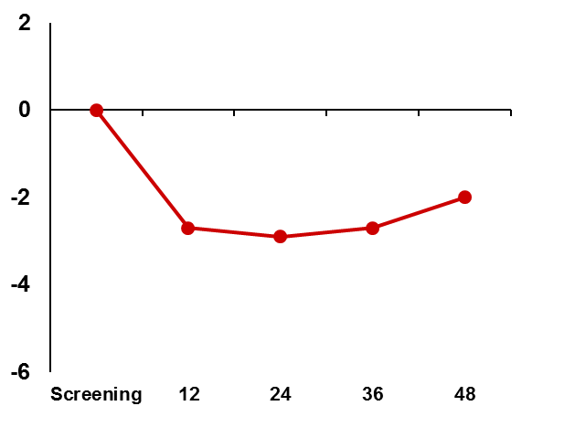
Changes in renal function associated with TDF/FTC
Open-label US PrEP Demo Project of 557 MSM and transgender women (TGW)
Median age 33; baseline median Cr 0.92 / median eGFR 97 mL/min.
Objective: evaluate changes in renal function over 48 weeks
3 patients required interruption of TDF/FTC for PrEP due to elevated Cr; all 3 patients re-started TDF/FTC for PrEP
34 (7%) of patients had >25% eGFR loss from baseline; only 4 (0.8%) confirmed on repeat testing
TFV-DP levels ≥ 4 doses/wk were associated with declines of ~4 mL/min in eGFR, compared with those with lower adherence
New onset eGFR <70mL/min (n=59; 13%) was more common with baseline eGFR <90 mL/min, particularly in older adults; may warrant additional monitoring
Mean change in eGFR
over 48 weeks, %
Mean % Change in eGFR from baseline(ml/min)
-2.8%
Bars indicate standard error
Week
FTC/TDF PrEP was associated with modest decline in eGFR and was non-progressive through Week 48. Older patients with baseline eGFR <90 mL/min more commonly experienced eGFR <70 mL/min
Liu A, et al. CROI 2016

Slide 18
Exclude the usual suspects
Don’t forget:
Hypertension
Check glucose
Nephrotoxic agents (e.g. aminoglycosides, NSAIDs)
Family history
Urine dipstix (no proteinuria)
Notes:
Continue PrEP

Slide 19
Change from baseline in bone mineral density (BMD) - iPrEX
1
.2
Spine (L1-L4)
1.2
Total Hip
0
.9
0.9
P
=0
.
001
P
=0
.
143
P
=0
.
049
0.6
0
.6
0
.3
P
l
a
ce
b
o
0.3
P
l
a
ce
b
o
Mean change from baseline, %
0.0
0
.0
-
0
.3
-0.3
-
0
.6
-0.6
TDF/FTC
TDF/FTC
P
<
0.001
P
=
0.002
P
=
0.540
-
0
.9
-0.9
-
1
.2
-1.2
0
24
48
72
0
24
48
72
Week
Week
P
l
a
ce
bo
247
199
1
24
59
2
47
199
1
2
4
59
FT
C/
T
D
F
2
56
2
03
124
5
9
256
20
2
12
5
5
9
Mean, SE and P-values by linear mixed model
Small but significant decreases in BMD at the spine, but not the hip, were observed in HIV-negative men randomised to TDF/FTC relative to placebo.
There were no differences in bone fractures between the groups (P=0.41)
Mulligan K, et al. CROI 2011

Slide 20
BMD recovers after cessation of TDF/FTC
  DEXA substudy of 498 subjects (median age 25; 446 MSM, 52 transgender women)
Recovery of spine BMD, by PrEP use and age
Recovery of hip BMD, by PrEP use and age
3
2
BMD recovered completely in BOTH hip and spine in young adults (<25yrs)
BMD recovered completely by enrollment in iPrEx OLE (median 73 wks) in both spine and hip
Although BMD declined in HIV-negative MSM/trans women with therapeutic levels of TDF/FTC on PrEP, BMD recovered completely in both older (>25) and younger patients within 6 months following discontinuation
Age <25
1
.
5
Age <25
2
1
1
Change in Hip BMD from iPrEx Enrollment, %
Change in Spine BMD from iPrEx Enrollment, %
0
.
5
0
0
-
1
Placebo
-
0
.
5
-
2
TFV-DP <16 at Week 24
-
1
*
*
TFV-DP ≥16 at Week 24
-
1
.
5
-
3
B
a
s
e
l
i
n
e
W
e
e
k
2
4
S
t
o
p
V
i
s
i
t
6
-
M
o
n
t
h
O
L
E
B
a
s
e
l
i
n
e
W
e
e
k
2
4
S
t
o
p
V
i
s
i
t
6
-
M
o
n
t
h
O
L
E
P
o
s
t
s
t
o
p
E
n
r
o
l
l
m
e
n
t
3
P
o
s
t
s
t
o
p
E
n
r
o
l
l
m
e
n
t
2
2
Age ≥25
1
.
5
Age ≥25
1
1
Change in Spine BMD from iPrEx Enrollment, %
0
.
5
0
Change in Hip BMD from iPrEx Enrollment, %
0
-
1
-
0
.
5
-
2
*
*
-
1
**
*
-
3
*
*
-
1
.
5
**
B
ase
li
n
e
W
eek
2
4
S
t
op
V
i
s
i
t
6
-M
on
t
h
O
L
E
B
a
s
e
li
n
e
W
ee
k
2
4
St
o
p
V
i
s
i
t
6
-
M
o
n
th
O
L
E
P
o
s
t
s
t
o
p
E
n
r
o
ll
m
e
n
t
P
o
s
t
s
t
o
p
E
n
r
oll
me
n
t
T
i
m
e
s
i
n
c
e
r
a
n
d
o
m
i
z
a
t
i
o
n
T
i
m
e
s
i
n
ce
r
a
ndo
m
i
z
a
t
i
o
n
*P<0.05; **P<0.001
iPrEx / iPrEx Open Label Extension (OLE): BMD Analysis
Grant R et al, CROI 2016

Slide 21
BMD changes in 18-24 year old MSM after discontinuing TDF/FTC PrEP
ATN 110 Study Extension Phase (EPH)
Extension Phase
DXA scans at 48 weeks after discontinuing PrEP study, i.e. 48 weeks on TDF/FTC followed by 48 weeks off TDF/FTC
N=72 individuals followed-up through the EPH
BMD change (mean) | From BL to Wk 48 (on TDF/FTC) | From Wk 48 to end of EPH (off TDF/FTC) | Overall change from BL to end of EPH
Hip | -1.43%* | +1.02%* | -0.35%
Whole Body | -0.63%* | +0.64%* | -0.11%
Lumbar Spine 1-4 | -0.25% | +1.15%* | +0.87%*
There is evidence of impact on bone density caused by exposure to TDF/FTC used as PrEP over 48 weeks in 18-22 year old males
Discontinuation of exposure to TDF/FTC leads to a trend to recovery of bone density changes over a 48 week follow-up period
Mulligan K, et al. AIDS 2016
Notes:
Transition:
Prior studies with TDF/FTC PrEP in older populations showed a modest bone loss by DXA scan, and a resolution of BMD loss once TDF/FTC PrEP was discontinued. Additional safety data in younger men are needed to support the PrEP use in this population.
Main Message:
1) There was evidence of BMD impact while exposed to TDF/FTC, and the % changes were similar to those seen in older populations;
2) All of the changes noted by DXA between Week 48 (discontinuation of TDF/FTC) and the end of the Extension Phase were in a positive direction;
3) Comparing DXA at the end of the extension phase to baseline, there is near normalization or recovery from TFV/FTC impact
Background:
ATN110 was a blinded and open label studies among MSM to support the efficacy of TDF/FTC for HIV prevention in young MSM (ages 18-22) in the US. Efficacy data was presented 2015. A paired study ATN 113 (ages 15-17) was presented AIDS 2016.
Baseline demographics:
Race: 53% black, 21% white, 17% hispanic/latino, 9% other/mixed/asian/Pacific Islander. Mean age 20.2 years.
Study flow: n=200 enrolled; n=135 completed Wk48 visit with DXA; n=102 fulfilled bone criteria for Extension Phase (in short, if <20 years: no increase in BMD to wk 48; if ≥20 years: ≥1% decrease in BMD); n=72 with DXA data through wk 48 of extension phase
Note: Bone density scanning, also called dual-energy x-ray absorptiometry (DXA) x-ray technology used to measure bone loss.

Slide 22
GI effects
ARV resistance
Renal
HBV management
BMD
Risk compensation

Slide 23
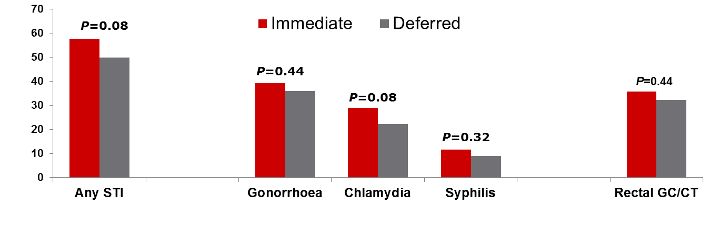
Risk compensation in PrEP clinical trials
PROUD⁴
Incidence of STI over follow-up, n
Grant R et al, CROI 2016
Grant R et al, N Engl J Med 2010
Baeten J et al, IAS 2011
McCormack S et al CROI 2015
There was no risk compensation seen in iPrEX, Partners PrEP, or PROUD

Slide 24
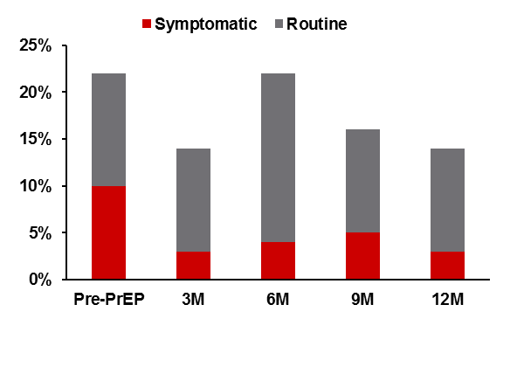
STI data from community-based PrEP implementation
Retrospective record review in SPARK (NYC);
Prospective cohort analysis in The Demo Project (SF, DC, Miami)
  In The Demo Project, transmission modeling suggested that q3mo screening prevented a median of 3 partners from being exposed to an STI via condomless anal sex
  Data from both projects indicate that not screening extra-genital sites and only following the CDC’s current STI screening guidelines would miss or delay many STI diagnoses
 | NYC SPARK (n=280)¹ | The Demo Project (n=557)²
STIs pre-PrEP | 21% | >25%
STIs on PrEP | 13-21% quarterly | 18-25% quarterly
STIs that CDC guidelines* would have missed (asymptomatic at 3M and 9M) | 77% at 3M; 68% at 9M | 34% GC; 40% CT; 20% syphilis
Extragenital STIs | 71-100% quarterly | 83% GC; 76% CT
NYC SPARK STI diagnoses by time point¹
  *Current CDC guidelines recommend STI screening every 6 mo and asking about symptoms quarterly
Golub S, et al. CROI 2016
Cohen S, et al. CROI 2016

Slide 25
References
Fonner VA, et al. Effectiveness and safety of oral HIV preexposure prophylaxis for all populations. AIDS 2016, 30:1973–1983
US Public Health Services. http://www.cdc.gov/hiv/pdf/guidelines/PrEPguidelines2014.pdf
Knox DC, et al. HIV-1 Infection with Multiclass Resistance despite Pre-exposure Prophylaxis (PrEP). Conference on Retroviruses and Opportunistic Infections, Boston, abstract 169aLB, 2016 CROI. 2016
Grossman H et al. Newly Acquired HIV-1 Infection with Multi-Drug Resistant (MDR) HIV-1 in a Patient on TDF/FTC-based PrEP. HIV Research for Prevention (HIVR4P) 2016 conference, Chicago, October 2016, abstract OA03.06LB.
Solomon M, et al. Changes in renal function associated with oral emtricitabine/tenofovir disoproxil fumarate use for HIV pre-exposure prophylaxis. AIDS 2014;28(6):851-9.
Mugwanya, K. Reversibility of kidney function decline in HIV-1–uninfected men and women using pre-exposure prophylaxis CROI, 23-26 February in Seattle, 2015.
Liu A, et al. Changes in renal function associated with TDF/FTC PrEP use in the US Demo Project. Presented at: Conference on Retroviruses and Opportunistic Infections; February 22-25, 2016; Boston, 2016
Grant RM, et al. Pre-exposure Chemoprophylaxis for HIV Prevention in Men Who Have Sex with Men. N Engl J Med 2010; 363:2587-2599
McCormack S and D Dunn for PROUD Study Group. Pragmatic Open-Label Randomised Trial of Pre-exposure Prophylaxis: The PROUD Study. 2015 Conference on Retroviruses and Opportunistic Infections. Seattle, February 23-24, 2015. Abstract 22LB

Slide 26
References
Baeten J, et al "Antiretroviral pre-exposure prophylaxis for HIV-1 prevention among heterosexual African men and women: The Partners PrEP Study." IAS 2011; Abstract MOAX0106.
Golub SA, et al. STI data from community-based PrEP implementation suggest changes to CDC guidelines. 23rd CROI, Boston. Poster abstract 869.
Cohen S, et al. Quarterly STI screening optimizes STI detection among PrEP users in the Demo Project. 23rd CROI, Boston, 2016. Poster abstract 70.
Grant R, et al. Recovery of bone mineral density after stopping oral HIV preexposure prophylaxis. 23rd CROI, Boston, 2016. Late breaker oral abstract 48LB.
Mulligan K, et al. Effects of FTC/TDF on bone mineral density in seronegative men from 4 continents: DEXA results of the global iPrEx Study. 18th Conference on Retroviruses and Opportunistic Infections; February 27-March 2; Boston, 2016. Abstract 94LB.

Slide 27

Acknowledgements
With thanks to:
The Southern African HIV Clinician Society (Michelle Moorhouse)
Wits Reproductive Health and HIV Institute
Anova Health Institute

