Slide 1
Clinical Management
Module 4 (c)
Stopping PrEP

Slide 2
Stopping PrEP
Positive HIV test
Request of user
Safety concerns
  Creatinine clearance < 60 mL/min
Risks outweigh benefits
Notes:
PrEP should be stopped: (1) whenever an HIV test is positive, (2) at client request, (3) for safety concerns (particularly if creatinine clearance < 60 mL/min) and (4) if the risks of PrEP outweigh the potential benefits. Ongoing linkage to appropriate HIV prevention services and contraceptive services should be encouraged, as well as the use of other HIV prevention strategies, as needed.
The duration of PrEP use may vary and individuals are likely to start and stop PrEP depending on their risk assessment at different periods in their lives – including changes in relationship status, behaviours and ability to adhere to a PrEP maintenance programme. Clients should be advised that an HIV test at minimum should be done before PrEP is recommenced. Clinicians may want to discuss the options of when to discontinue PrEP with their clients.

Slide 3
Cycling on and off PrEP
When starting
  For anal sex: 7 days of daily TDF/FTC to reach adequate tissue levels
  For vaginal sex: 20 days
  Use other methods of protection
When stopping
  Continue PrEP for 28 days after last potential HIV exposure
Notes:
A reminder should be given that, if restarting PrEP, adequate protection only occurs after 7 days of dosing. HIV-negative status should be confirmed before restarting PrEP. If stopping PrEP, medication should be taken for 28 days after the last potential exposure to HIV.
Taking PrEP for 28 days after the decision to stop (and after last exposure to HIV) is based on a WHO recommendation. There is not enough evidence to know exactly how long PrEP is actually effective after stopping.

Slide 4
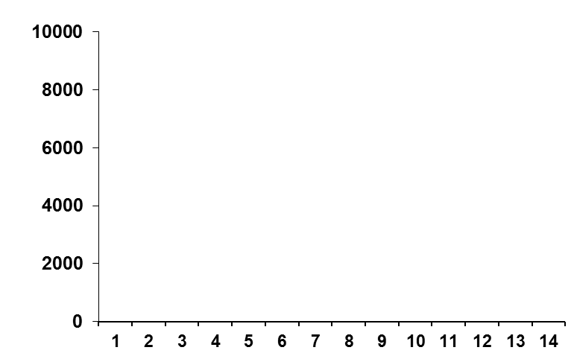
Women: PK differences in various mucosal tissues
TFV concentrates 10-100X more in rectal tissue than in cervicovaginal tissue
Minimally effective use for FGT-rectal tissue exposure = 7 doses/week
10000
1000
100
10
1
100
Tenofovir-DF
Emtricitabine
TDF+FTC
Rectal tissue
Vaginal tissue
Cervical tissue
80
60
Concentration (ng/g)
Acheving target ratio in FGT tissue, %
40
20
0
1 2 3 4 5 6 1 2 3 4 6 7 1 2 3 4 5 6
Days post single-dose
Doses per week
TFV concentration is sustained longer in rectal tissue in women
TFV exposure was 2- to 160-fold greater in rectal tissue than cervical/vaginal tissue in women
FTC-DP exposure was 80- to 280-fold greater in cervical/vaginal tissue than rectal
Patterson K, et al. Sci Transl Med. 2011
Cottrell M. R4P 2015

Slide 5
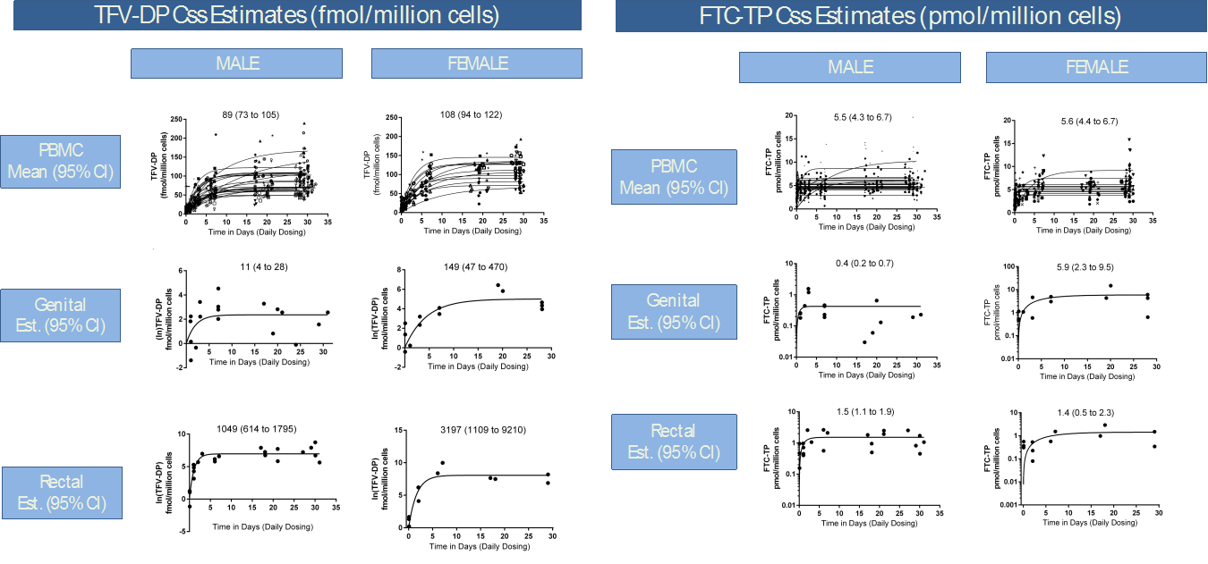
Steady-state concentrations of TDF/FTC metabolites in male and female genital, rectal, and blood compartments
PK study of daily TDF/FTC for 30d in HIV-infected and uninfected adults (n=40)
Levels of intracellularly active moieties (TFV-DPª, FTC-TP^{b}) were measured in PBMC^{c}, rectal biopsies, cervical brush collections, and semen samples to determine average steady-state concentrations (Css)
Rectal compartment had higher concentrations of TFV-DP than blood or genital
Female genital cell concentrations were
~10x higher than male for both TFV-DP and
FTC-TP
Differential drug penetration by compartment and sex may help inform dose-response relationships in the prevention and treatment of HIV
a tenofovir-diphosohate
b emtricitabine-triphosphate
c peripheral blood mononuclear cells
Siefert S. et al. CROI 2015

Slide 6
PrEP efficacy: Modeling data
Predictors of Higher Drug Concentrations:
Older age (>30 years old)
Secondary or post-secondary education
Condomless receptive anal intercourse
Multiple sexual partners (> 5 in 3 months)
Having an HIV+ partner
 | HIV risk reduction, %
Partners PrEP¹
Any tenofovir | 90
iPrEx/iPrEx OLE²
Any tenofovir | 92
4 doses/week | 96-100
7 doses/week | 96-100
Baeten J, et al. N Engl J Med 2012
Grant R, et al. N Engl J Med 2010
Anderson et al. Science Transl Med 2012
Buchbinder S, et al. Lancet ID 2014

Slide 7
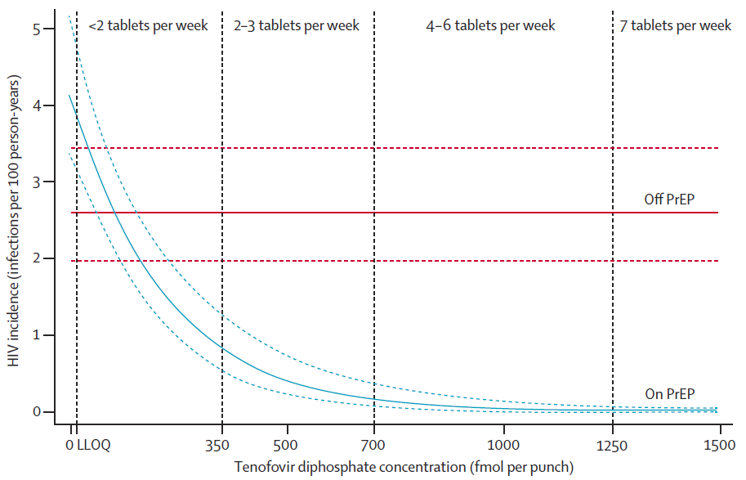
HIV incidence and drug concentrations in MSM
Modeling data from subjects in randomised placebo-controlled iPrEx, ATN 089, or US PrEP safety trials who were enrolled in the 72-week open label extension (iPrEx OLE)
No infections in those with
drug levels equal to ≥4 tabs/wk
Drug Concentration | none | <2 pills/ week | 2-3 pills/ week | 4 pills/ week | 7 pills/ week
HIV Incidence per 100 PY (95%CI) | 4.7 (2.99-7.76) | 2.25 (1.19-4.79) | 0.56 (0.00-2.50) | 0 | 0
Risk Reduction (95%CI) |  | 44% (-31-77) | 84% (21-99) | 100% (86-100)
Recommended dose of TVD for PrEP in HIV-1 uninfected adults:
One tablet once daily taken orally with or without food
Buchbinder S, et al. Lancet ID 2014

Slide 8
References
US Public Health Services. 2014
Consolidated guidelines on the use of antiretroviral drugs for treating and preventing HIV infection. Recommendations for a public health approach. Second edition. 2016. World Health Organization.
Patterson K, et al. Penetration of tenofovir and emtricitabine in mucosal tissues: implications for prevention of HIV-1 transmission. Sci Transl Med. 2011, 3(112):112re4.
Cottrell M. Predicting Effective Truvada® PrEP Dosing Strategies With a Novel PK-PD Model Incorporating Tissue Active Metabolites and Endogenous Nucleotides HIV Research for Prevention (R4P) Cape Town, South Africa. 2014.
Seifert SM, et al. Steady-state TDF/FTC in Genital, Rectal, and Blood Compartments in Males vs Females. CROI 2015
Baeten J, et al. Antiretroviral Prophylaxis for HIV Prevention in Heterosexual Men and Women. N Engl J Med 2012; 367:399-410.
Grant R, et al. Pre-exposure Chemoprophylaxis for HIV Prevention in Men Who Have Sex with Men. N Engl J Med 2010; 363:2587.
Anderson, et al. Emtricitabine-tenofovir exposure and pre-exposure prophylaxis efficacy in men who have sex with men. Sci Transl Med. 2012, 4(151): 151ra125.
Buchbinder S, et al. HIV pre-exposure prophylaxis in men who have sex with men and transgender women: a secondary analysis of a phase 3 randomised controlled efficacy trial. Lancet Infect Dis. 2014 ; 14(6): 468-75.

Slide 9

Acknowledgements
With thanks to:
The Southern African HIV Clinician Society (Michelle Moorhouse)
Wits Reproductive Health and HIV Institute
Anova Health Institute

