Slide 1
Sensitisation and Communicating about PrEP
Module 5 (a)

Slide 2
Session overview
PrEP promotion and messaging
Understanding user groups
Communicating about PrEP
PrEP user in context
Key messages
Eligibility
Condom use
Counseling
Education and awareness
Safety and effectiveness
Impact on lifestyle

Slide 3
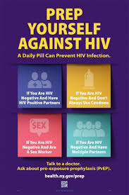
PrEP promotion and messaging
PrEP promotion
Focuses on larger scale roll out
Not the focus of this presentation
PrEP messaging
Focused on the individual PrEP user
Aimed at healthcare providers providing PrEP services
Can be adapted for peer education and outreach

Slide 4
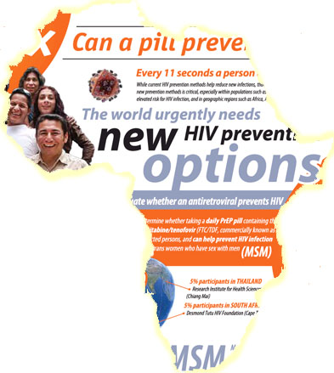
Promoting PrEP
Key points:
Community consultation and support
Peer-led and informed
Appropriately targeted marketing
Demand creation and education is essential for broader PrEP roll out
Community sensitisation, messaging and outreach must be targeted to each audience/key population – segmentation
May also be sub-groups within each key population
Design messages for youth, MSM, sex workers, serodiscordant couples, people who inject drugs, other key populations
Outreach an important component
Innovative technology

Slide 5
PrEP in Chicago

Slide 6
PrEP in South East Asia

Slide 7
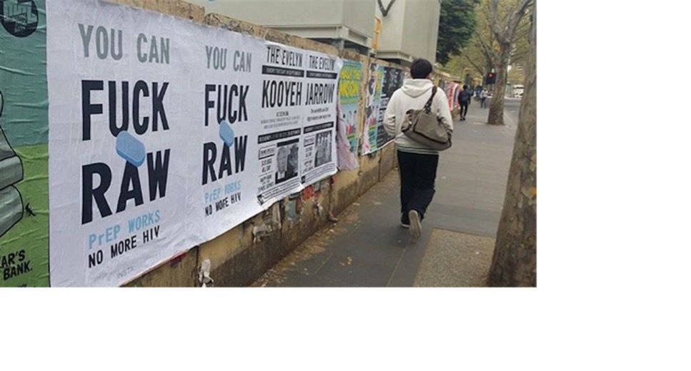
PrEP in Australia

Slide 8
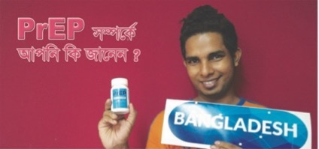
PrEP around the world

Slide 9
PrEP in South Africa

Slide 10
PrEP in South Africa
PrEP videos:
https://www.youtube.com/watch?v=Uc0mFNqoQcY
http://www.wethebrave.co.za/all-you-need-to-know-about-prep/

Slide 11
PrEP messaging
Why PrEP messaging is important
Understanding the PrEP user perspective and context
Key messages

Slide 12
Importance of messaging
Large-scale PrEP access is limited
This means you will be a significant source of PrEP information and access
You will have the responsibility of clarifying misinformation and stigma
Your messaging will be disseminated through larger community

Slide 13
Understanding user groups
Group 1
People who do not need PrEP
Group 2
Group 3
People who take PrEP but do not need it
Group 4
People who need PrEP, want PrEP, and will take PrEP
People who could benefit from PrEP
Don’t want PrEP as only being for “high risk” behaviours, this can result in stigmatisation
PrEP messaging is important – to all concerned
If messaging is only aimed at low risk populations then high risk populations may not uptake the service
Word of mouth/network conversations important!
Influences the broader conversation of PrEP and level of uptake among key populations
Peoples’ circumstances change over time
Provides an effective option for HIV prevention
Notes:
PrEP users can be described across four specific groups defined by their level of risk, their level of exposure to PrEP, and their willingness/need to use PrEP

Slide 14
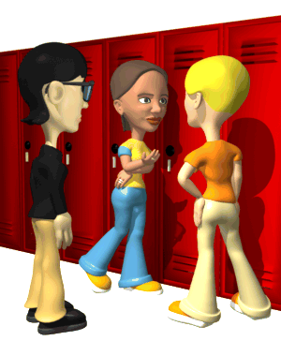
Understanding user groups
There is a broad conversation already happening about PrEP and a lot of misinformation and questions circulating
What if I forget to take my PrEP?
I am taking hormones – can I also take PrEP?
PrEP will affect your sexual performance
PrEP is an antiretroviral so people who take PrEP must be HIV-positive
PrEP is only for MSM who have anal sex. I only have vaginal sex so I don’t think its for me.
When can you take PrEP?
Can you drink alcohol when using PrEP?
What is the difference between PrEP and PEP?
Notes:
There is a broad PrEP conversation already happening about PrEP and a lot of misinformation and questions circulating

Slide 15
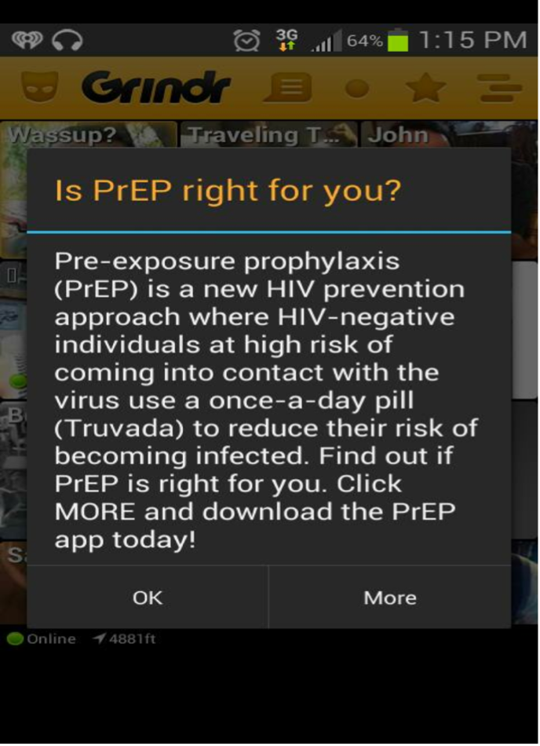
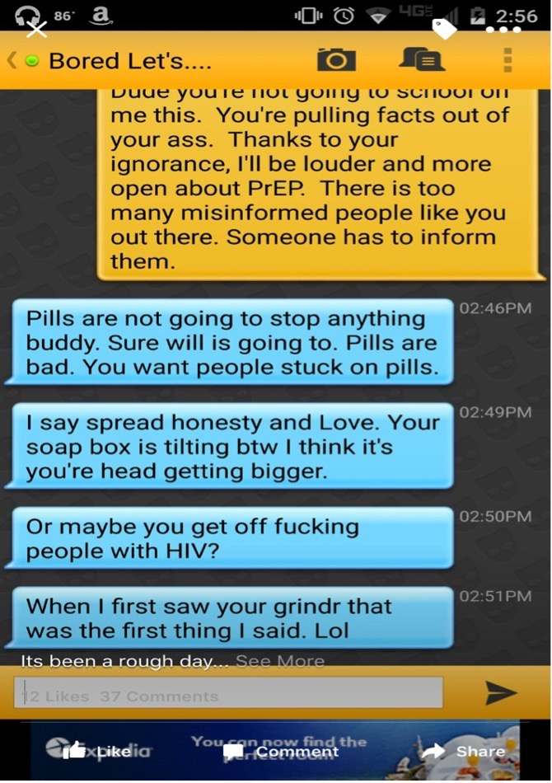

Slide 16
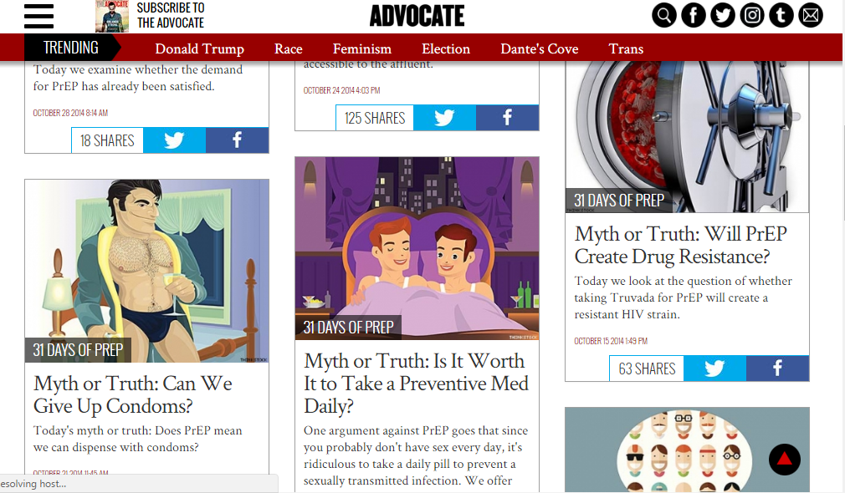

Slide 17
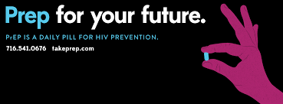
Communicating about PrEP – adapt to context
There is a broad PrEP conversation already happening and a lot of misinformation out there
PrEP users are diverse
Reasons for using PrEP vary widely and change over time

Slide 18
PrEP user in context
Key issues to consider:
High burden of disease
Social pressures and norms
Partner and contextual risks

Slide 19
Communicating about PrEP: Individual circumstances and needs vary
“ I started taking PrEP because when I first moved to Cape Town, I went out for drinks and this older guy picked me up. I don’t really remember what happened but I know that he had sex with me. When I asked him the next morning if he used a condom, he just said….”
“…I mean, what was I supposed to do, who uses condoms in a 9 month relationship? That means you don’t trust some one. I use PrEP because I don’t want to have to rely on someone else’s behaviour to stay negative.”
“… didn’t scare me that she [my friend] got it [HIV]. What scared me was that she and I had been doing the same [sexual] stuff. So I guess I didn’t get it [HIV] because I’m lucky and I’d rather not rely on luck any more.”

Slide 20
PrEP user in context
Lots of misinformation out there
PrEP users are diverse
Reasons for using PrEP vary widely and change over time
PrEP is a dynamic strategy designed to address these contextual situations

Slide 21
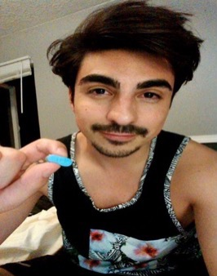
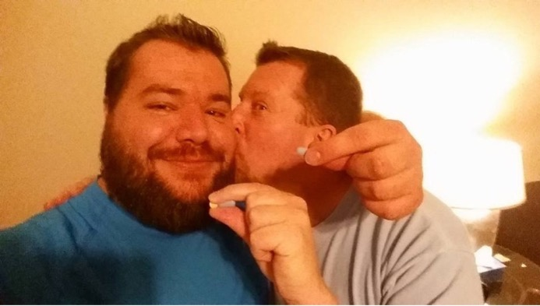
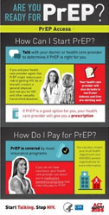
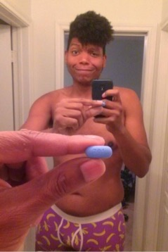
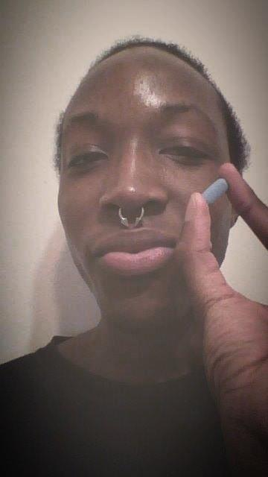
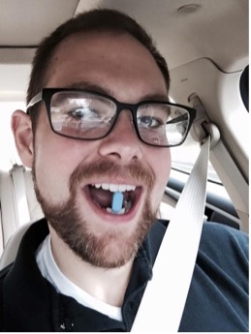
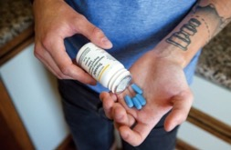

Slide 22
Key messages
What is PrEP?
How do I take it? Is it for me?
Okay but what about the side effects?
Shouldn’t I be worried about resistance?
Do I have to stay on it forever?
So why should I take it?
So can people use PrEP and not use condoms?
Education and Awareness
Safety
Impact on Personal Lifestyle

Slide 23
Key messages: Choose your words carefully
“PrEP is a very strong medication with side effects, you should consider if those risks are worth it for you or not.”
OR
“Many studies have proven that PrEP is safe. There are predictable side effects for some people that go away in time. I will also run tests to make sure you are healthy before starting PrEP.”
“PrEP should only be used with condoms and lubricant and be part of HIV and STI testing.”
OR
“PrEP is an effective way to prevent HIV. It doesn’t protect against other STIs so it works best when combined with condoms and testing.”

Slide 24
Key messages
Per guidelines, messaging can and should be provided during:
Education and information
Screening and assessing for eligibility
Initiation and follow up
Counselling

Slide 25
Commonly asked questions
What is the difference between PrEP and ARVs?
Can you take PrEP with drugs and alcohol?
How long does it take for PrEP to work?
Why is PrEP taken daily as if one is on chronic medication?
Why does PrEP have same ingredients as ARVs?
Does the medication have side effects?
What happens if one forgets to take PrEP for a day?
If one seroconverts, won’t taking PrEP cause them to become resistant to ARVs?

Slide 26
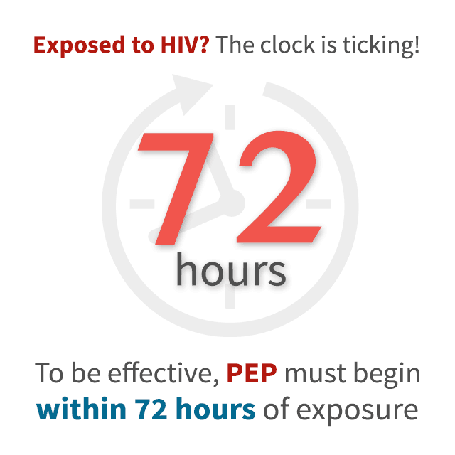
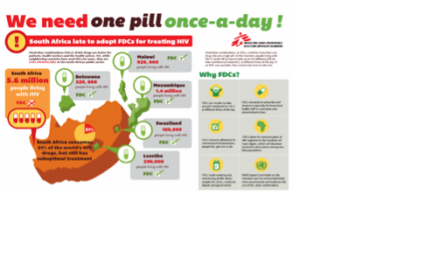
Key message: PrEP vs. PEP vs. ART
PrEP | PEP | ART
Pre-Exposure Prophylaxis ARV taken before exposure to HIV Prevents HIV acquisition | Post-Exposure Prophylaxis ARV taken after exposure (within 72 hours) for 28 days to prevent HIV | Treatment Life long treatment to minimise the effect of HIV, strengthen the immune system - reduce viral load, and increase CD4 count
Notes:
Very important that we clarify the difference between PrEP, PEP, and ART, as many people get confused. Particularly in counselling, communication, peer education, training, etc.

Slide 27
Messaging - eligibility
Defining ‘substantial risk’ is difficult.
Anyone who requests PrEP should be screened, regardless of reported risk.
Message:
PrEP is a safe and highly effective medication that can prevent HIV. If you think that you might be exposed to HIV, then this is something you should consider.

Slide 28
Messaging - eligibility
Someone comes into your clinic who is very low risk, but they are increasingly worried about getting HIV. They have no plans to increase their risk behaviour. How do you tell them that they are not eligible?
Do you say…
Sorry, you’re not high risk enough for PrEP.
Sorry, PrEP is only for people who are really risky and you aren’t high risk enough.
Or rather say…
“It’s really great that you want to take care of your health.”
“PrEP is a great way to prevent HIV but it isn’t for everyone.”
“You’re doing a great job staying negative as it is.”
“We can easily discuss PrEP anytime if you feel like your risk will increase in the future.”

Slide 29
Messaging – condom use
Someone comes to your clinic and would like to start PrEP. They are already inconsistent with their condom use and plan to stop using them all together. For this client, they are condom fatigued, they enjoy not using condoms, and they live in a cultural context that supports it.
Do you say…
Condoms are the best way to stay HIV negative and protect yourself from STIs. You should try to use condoms.
I worry about giving you PrEP if it is going to make you have more unprotected sex.
Or rather say…
“It’s really great that you want to prevent HIV”
“Let’s look at your risk and options to prevent HIV”
“Here is more information about PrEP - how it works, and how to use it so that it is effective…you need to decide if it is for you”
“PrEP is a really great way to prevent HIV. It doesn’t protect against other STIs, so if you aren’t using condoms then we need to regularly test you for other STIs.”

Slide 30
Key counselling messages
Some providers have been uncomfortable with this messaging and with this scenario – what do you think?
Chances of traditional messaging being effective are low. (eg, Do you floss daily?)
Will this eliminate risk? NO
Will this improve risk? YES
PrEP can help establish a longer term relationship with this user through which more challenging risks can be addressed over time.

Slide 31
Messaging - starting and stopping PrEP and effectiveness
People who only have anal sex: You need 7 days of daily dosing with oral PrEP to reach adequate anal/rectal tissue levels
People who have vaginal sex: you need 20 days of daily dosing with oral PrEP to achieve protective vaginal tissue levels
During this period, other protective precautions must be used, such as abstinence or condoms.
This needs to be taken into account in users who stop and start PrEP according to their periods of risk.
PrEP medications should be continued for 28 days after the last potential HIV exposure in those wanting to cycle off PrEP.

Slide 32
Summary messages: Education and awareness
PrEP is a pill that you take everyday to stay HIV-negative
The use of PrEP is supported by South African medical experts, the South African government, and many international experts
Before you start PrEP, you will meet with your healthcare provider to make sure PrEP is right for you
PrEP does not protect you against other STIs - so using condoms and PrEP together will give you the best level of protection from both HIV and other STIs
PrEP does not protect you against pregnancy so using condoms, contraception, and PrEP will give you the best protection against pregnancy, HIV, and STIs.

Slide 33
Summary messages: Safety and effectiveness
PrEP has been proven to be safe and highly effective in preventing HIV
Many studies have proven that PrEP is safe. There are predictable side effects for some people that go away in time. I will also run tests to make sure you are healthy before starting PrEP.
You need to take PrEP every day to get the best level of protection from it. If you do not take PrEP correctly, it will not protect you from HIV if you are exposed.

Slide 34
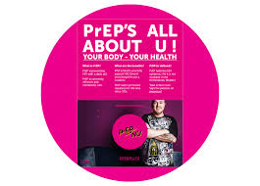
Summary messages: Impact on lifestyle
There are many different reasons for taking PrEP and your reasons for taking PrEP may change over time.
If you start PrEP you do not have to take it for the rest of your life.
PrEP will help protect you from HIV even if you do not change your behaviour or your lifestyle.
Using condoms and PrEP together will give you the most protection. If you are not using condoms then you should test for STIs more frequently.
You can take PrEP with alcohol and drugs.
You will need to see your healthcare provider regularly.

Slide 35
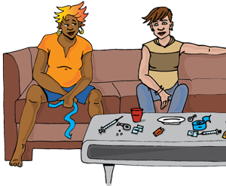
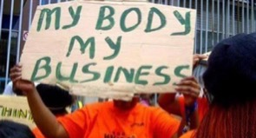
Summary messages: Some final considerations
Do you offer a safe environment for clients to discuss PrEP?
Do you feel comfortable recommending PrEP as a primary HIV prevention strategy?
Do you feel comfortable working with MSM, sex workers, serodiscordant couples, people who inject drugs, and young people?

Slide 36
YOU are a communication tool!
Remember the most important communication comes from YOU, the healthcare worker!
Be welcoming and non-judgemental
Be consistent – clients talk to each other!
Answer questions honestly
Be positive and encourage questions
Be supportive

Slide 37
Acknowledgements
With thanks to:
The Southern African HIV Clinician Society
Anova Health Institute (Ben Brown, Dr. Kevin Rebe)
Wits Reproductive Health and HIV Institute
The OPTIONS Programme/South Africa (Melanie Pleaner)

