Slide 1
Supporting Effective PrEP Pill Taking and Providing HIV Risk Reduction Counselling
Module 5 (b)

Slide 2
Session overview
PrEP counselling
Integrating PrEP into standard HIV risk reduction practices
Case studies
PrEP and HIV risk reduction
Strategies to support effective pill taking
Good counseling messages
Support for effective pill taking
Integrated PrEP counselling strategies

Slide 3
Aim of PrEP counselling
The aim of PrEP counselling is to ensure your client is effective at following the daily PrEP regimen and in doing so, reducing their risk for HIV infection.
This includes aspects of both:
HIV risk reduction
Support for effective pill taking

Slide 4
PrEP counselling: Key points
Recognise that changing sexual or risk behaviours is equally (if not more) complicated than changing behaviours associated with non-communicable diseases
Correct and evidence-based information should be provided to PrEP users as well as the delivery of other prevention strategies
Counselling PrEP users is an individualised process but is easily integrated

Slide 5
Integrating PrEP into standard HIV risk reduction practices
Strategies to support effective pill taking
Integrated PrEP counselling strategies

Slide 6
Traditional HIV risk reduction counselling
HIV risk reduction counselling focuses on changing behavioural practices to eliminate risk of HIV exposure
HIV risk is influenced by more than just individual behaviour (i.e. structural risks, community practices, etc.)
These additional influences are hard to address clinically
Such behaviour change counselling requires long term engagement with clients
Consider Peter’s story….

Slide 7
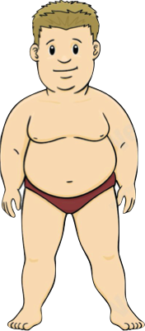
Meet Peter
Peter is one of your clients who:
is overweight
has a poor diet
does not exercise
has high cholesterol
overall significant risk of MI
What do you do/recommend for Peter?

Slide 8
Three months later…
Peter is still:
overweight
eats Steers/KFC 3-4 nights per week
does not exercise
takes his cholesterol medication

Slide 9
Three months later…
Are you surprised?
What drives Peter’s behaviour?
Immediate gratification is stronger than long term gain
Behaviour change is hard
What kind of plan would you make for Peter?
Running marathons vs. light exercise and diet?

Slide 10
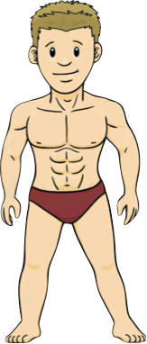
Meet Paul
Paul is one of your clients who:
comes for HIV testing regularly
has multiple male sexual partners
struggles to use condoms all of the time
uses alcohol and other substances
overall significant risk for HIV infection

Slide 11
Paul has essentially the same risk profile as someone who is overweight and doesn't diet. But does he get treated the same?
We treat these situations differently because:
Sex makes us (HCW) uncomfortable; more so than advising about weight loss and health
We inherently understand and treat infectious disease (ID) risk differently than non-communicable disease (NCD)
Tackling risk is highly contextualised and personalised process – limited tools for healthcare providers to do this effectively.

Slide 12
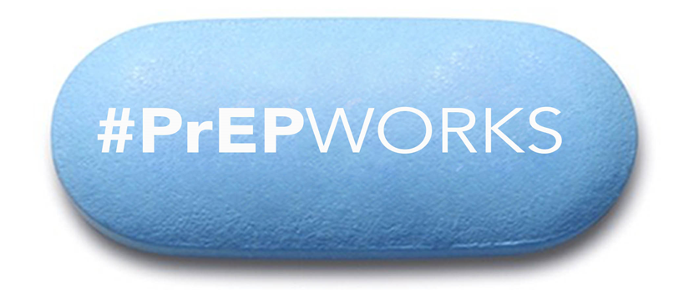
PrEP and HIV risk reduction
PrEP is now a tool we can add to the HIV prevention tool kit that can fill gaps left by other prevention measures
PrEP counselling integrates well with current practices and can be conducted by lay counsellors, nurses, and clinicians
PrEP may support achievable risk reduction where traditional prevention strategies have failed
For example….

Slide 13
Unprotected Anal Sex
Substance Use
Multiple Sex Partners
Sex Work

Slide 14
Unprotected anal sex
Substance use
Multiple sex partners
Sex work
Uses condoms all the time
Monogamous

Slide 15
Unprotected Anal Sex
Substance Use
Multiple Sex Partners
Sex Work
High risk for HIV
No risk for HIV
Uses Condoms all the time
Monogamous

Slide 16
Unprotected Anal Sex
Substance Use
Multiple Sex Partners
Sex Work
High risk for HIV
No risk for HIV
Uses Condoms all the time
Monogamous

Slide 17
Unprotected Anal Sex
Substance Use
Multiple Sex Partners
Sex Work
Standard counselling tells us to push people down this cliff of behaviour change
High Risk for HIV
No Risk for HIV
Uses Condoms all the time
Monogamous

Slide 18
But is this realistic?
How easy is it for patients to change?
Is this sustainable?
Unprotected Anal Sex
Substance Use
Multiple Sex Partners
Sex Work
High risk for HIV
No risk for HIV
Uses Condoms all the time
Monogamous

Slide 19
Unprotected anal sex
Multiple sex partners

Slide 20
Unprotected anal sex
Multiple sex partners
Maybe someday?
Uses condoms all the time
Monogamous

Slide 21
Unprotected anal sex
Multiple sex partners
Maybe someday?
Uses condoms all the time
Monogamous

Slide 22
Unprotected Anal Sex
Multiple Sex Partners
High risk for HIV
Comes for testing every month
Lower risk for HIV
Maybe someday?
No risk for HIV
Uses Condoms all the time
Monogamous

Slide 23
Unprotected anal sex
Multiple sex partners
Comes for testing every month
Maybe someday?
Uses condoms all the time
Monogamous

Slide 24
Unprotected Anal Sex
Multiple Sex Partners
High risk for HIV
Comes for testing every month
Lower risk for HIV
Starts using PrEP
Very low risk for HIV
Maybe someday?
No risk for HIV
Uses Condoms all the time
Monogamous

Slide 25
Considering where our patient comes from:
he is still at some risk for getting HIV but is this level of risk relevant?

Slide 26
What could have happened if we just told our patient to use condoms from the beginning?

Slide 27
PrEP is different from other prevention measures
Great because people make decisions about PrEP in “cold” states (i.e. behavioural economics theory)
PrEP is empowering and doesn’t require a significant or immediate change in lifestyle, users feel like they can keep doing what they do and stay safe.
Establishes a useful long-term relationship to address other risks
PrEP still relies on some form of behaviour change in order to reduce HIV risk (i.e. pill taking).

Slide 28
Integrating PrEP into standard HIV risk reduction practices
Strategies to support effective pill taking
Integrated PrEP counselling strategies

Slide 29
Pill-taking vs. adherence
Adherence = pill-taking
PrEP is not treatment
Would you tell someone to be adherent to condoms?
Supporting pill-taking should be honest, direct, and non-judgemental.
The key to pill-taking counselling is establishing an open, honest relationship.
Recognise that taking a daily pill for an otherwise healthy person may require coaching but is highly achievable

Slide 30
Examples of good counselling messages
“You’ve decided to use PrEP as a way to protect yourself and that's great.”
“Pill taking isn’t easy and takes some practice, especially if you aren’t used to taking pills.”
“It's okay to not be perfect at taking your pills, it takes time. But remember, in order for PrEP to work you have to take your pills regularly.”
“I’m here to help by working with you to figure out a way to make taking your pills easier, so that you get the most protection you can.”

Slide 31
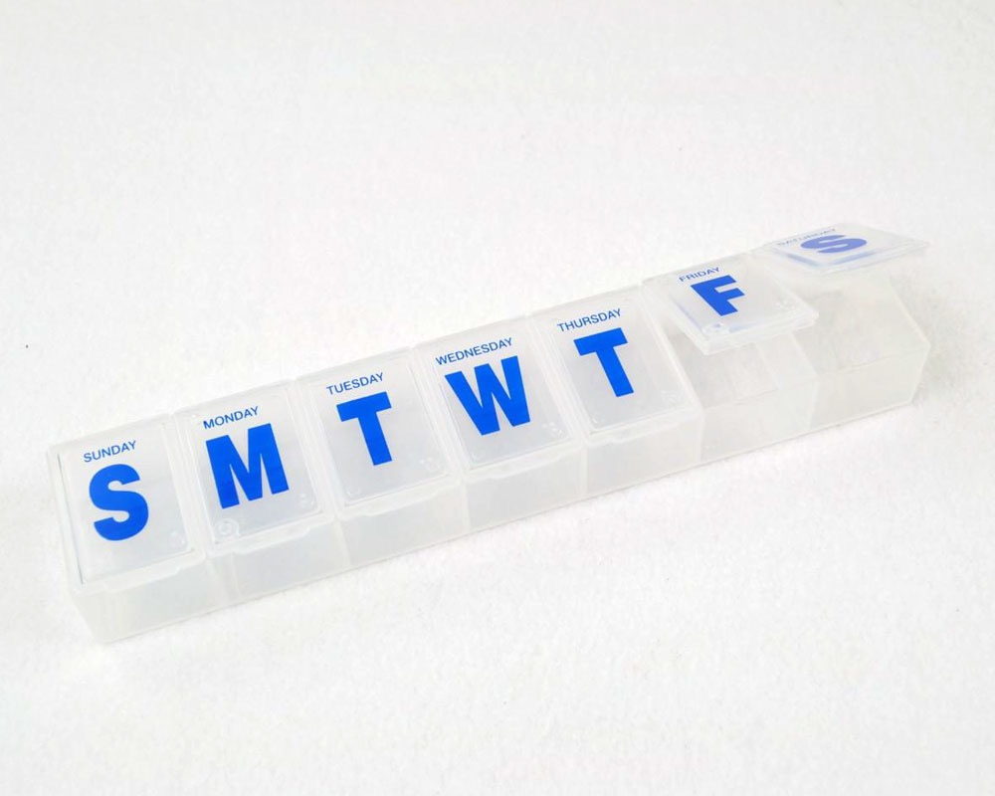
Tips for supporting PrEP pill-taking
Schedule medication taking time to correspond with the patient’s daily routine activities
Use reminders e.g. cellphone, alarms, beepers, calendars
Use of pillboxes
Review disclosure issues to identify those who can support the patient’s intentions to take their pills or barriers to pill-taking due to lack of disclosure/privacy at home
Join an on-line support group e.g. Facebook: PrEP Rethinking HIV Prevention or #wethebrave
Guidelines for Expanding Combination Prevention and Treatment Options for Sex Workers: Oral Pre-Exposure Prophylaxis (PrEP) and Test and Treat (T&T), Department of Health, April 2016

Slide 32
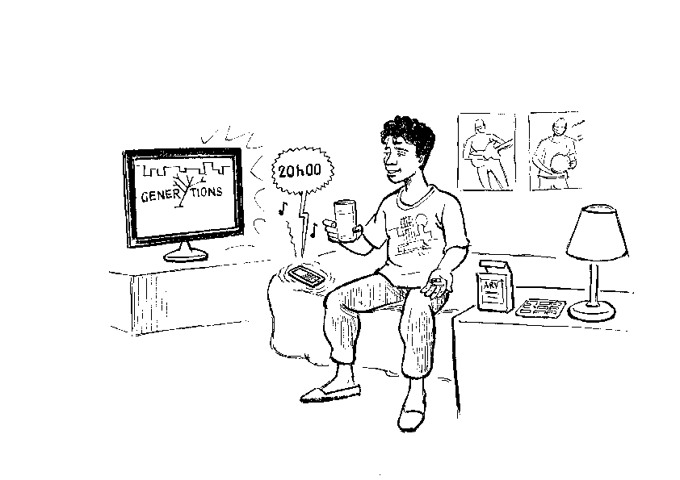
Tips for supporting PrEP pill-taking
Use alternative methods of communication: SMS, social networking, mobile applications
Integrate mobile services and outreach into existing services
Enhance peer support strategies, such as the use of clubs
Provide alternative clinic hours, if possible
Collect additional contact information for each patient
Provide patients in advance with referral partners in the event that they migrate, or provide with additional stock/prescription
Guidelines for Expanding Combination Prevention and Treatment Options for Sex Workers: Oral Pre-Exposure Prophylaxis (PrEP) and Test and Treat (T&T), Department of Health, April 2016

Slide 33
Integrating PrEP into standard HIV risk reduction practices
Strategies to support effective pill taking
Integrated PrEP counselling strategies

Slide 34
PrEP counselling: A combined approach
The effective use of PrEP tremendously reduces risk of HIV infection
Therefore, being effective with PrEP pill-taking is a strategy to achieve HIV risk reduction
Why two different forms of counselling?
Combined counselling brings together risk reduction and pill-taking in order to save time and remain relevant to the PrEP user

Slide 35
PrEP counselling: A combined approach
“Integrated Next Step Counselling” was used throughout the iPrEX trial and many biomedical HIV prevention strategies, developed by Rivet Amico
This is not prescriptive; other counselling strategies with similar scope or your current practices can also be used (i.e. motivational interviewing)
PrEP counselling places emphasis on reducing risk in a sustainable way rather than eliminating it entirely in one go

Slide 36
PrEP counselling: A combined approach
Client-driven, based on their needs, resources, and preferences – it is not prescriptive
Recognises that behaviour change is not easy and human beings are not perfect
Focus on the identification of “small wins”, more achievable “next steps”, in reducing risk and/or making pill taking easier

Slide 37
Supporting effective pill-taking
Assess how pill-taking is going for PrEP client
Positively affirm client to support provider/client relationship
Identify a motivator to support effective pill-taking
Provide PrEP education regarding effective use and effectiveness of PrEP
Identify barriers to effective use
Provide realistic strategies to address barriers
Discuss use of other HIV prevention measures that are relevant to the situation
Client leaves with realistic and achievable plan to increase or sustain use

Slide 38
Supporting effective pill-taking
Assess how pill-taking is going for PrEP client
Sipho has been taking PrEP for three months but explains that he has not been able to use it regularly in the last month.
Positively affirm client to support provider/client relationship
“Getting in the habit of taking pills can be tough but it’s great that you’ve brought this up so that we can work together to find a solution”
Identify a motivator to support effective pill-taking
“I see that you’ve been taking PrEP for three months now, what has that been like for you?”
Sipho acknowledges that he hasn’t been using condoms with his sexual partners and that taking PrEP has given him a great deal of peace of mind. “I’m glad that you are taking PrEP if you aren’t using condoms regularly.”

Slide 39
Supporting effective pill-taking
Provide PrEP education regarding effective use and effectiveness of PrEP
“Remember, it’s okay to miss 2 or 3 of your PrEP tablets, you will still have some protection against HIV but its best to take it daily. If you are missing more than 2 or 3 of your tablets each week it can reduce its ability to protect you from HIV. Let’s figure out a way to help get you there together.”
Identify barriers to effective use
Sipho explains that he has been spending a lot of weekends away from his place and travelling for work. He either forgets to bring his tablets or leaves them at home because he feels uncomfortable.
[Identified barriers: Change in Routine/Disclosure Issues]
[Consider: Which could be the easiest to implement right away to increase his use]

Slide 40
Supporting effective pill-taking
Provide realistic strategies to address barriers
“I know it can be tough when you change your routine to remember to take your tablets. Have you tried using a non-labeled pill container? This will be discreet and easy to carry with you…What other ways do you think would be useful?”
Discuss use of other HIV prevention measures that are relevant to the situation
“Let’s schedule another appointment in a few months just to update your STI screening. Making sure we keep you treated for STIs will also help reduce your chances of getting HIV.”
Client leaves with realistic and achievable plan to increase or sustain use
Sipho will keep a back up of his medication in his weekend or travel bag as an extra protection against forgetting to bring it.

Slide 41
Summary
Discussing effective PrEP use with your client should be open and affirming.
Risk behaviour change is hard (just like other examples in life) and may take a long time to adjust
Many practices may not have the capacity to address realistic traditional behaviour change
Supporting effective PrEP use among your clients is a new opportunity to address HIV risk in an effective, efficient, and achievable way

Slide 42
The essentials: Building a strong foundation for effective PrEP use
When initiating a new client onto PrEP or supporting a long term user, you must:
Ensure that proper education has been provided regarding PrEP use, required lead in times, dynamics of cycling, and required use for protective levels
Ensure that your client leaves with a plan in place to support their pill-taking, identify at least one potential barrier, and identify a solution for that barrier

Slide 43
A final thought
Consider this:
If you can focus your time and energy into ensuring that your client is able to effectively take their PrEP medication then they will be leaving your facility with an additional 92%-100% protection against HIV.
Has there ever been a time in your practice where you have been able to provide that level of protection to a client?
How does this make you feel?

Slide 44
Acknowledgements
With thanks to:
The Southern African HIV Clinician Society
Anova Health Institute (Ben Brown, Dr. Kevin Rebe)
Wits Reproductive Health and HIV Institute
The Elton John AIDS Foundation
Health4Men
Right to Care
PEPFAR and USAID

