Slide 1
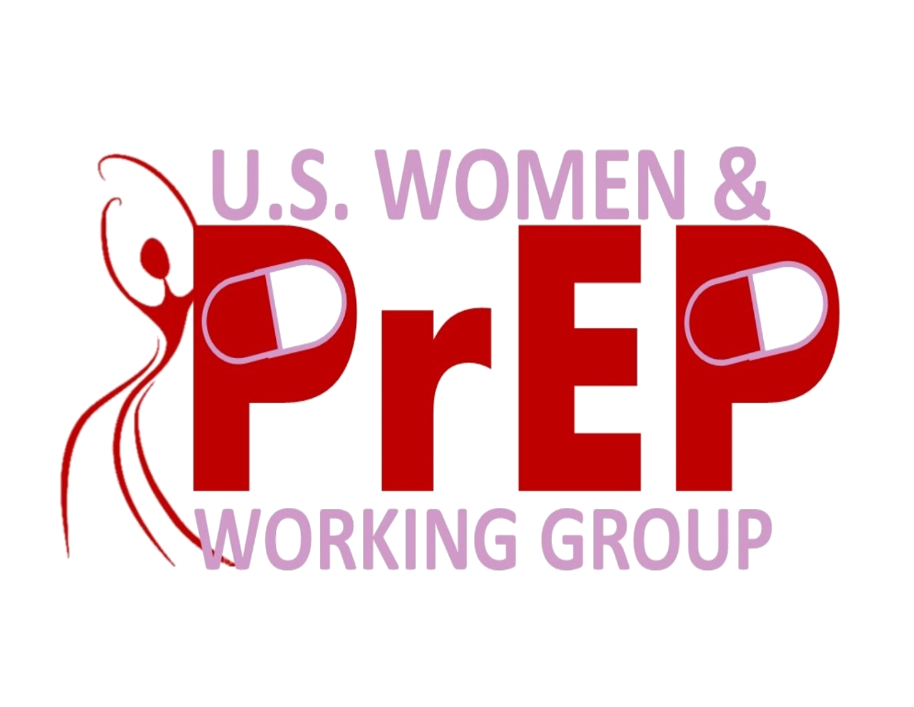
A pill to prevent HIV?
For women??
PrEP
Notes:
[Note to speaker: Please introduce yourself and your organization. Explain why you are making this presentation and why HIV prevention is important to you.]
These slides were prepared by the US Women and PrEP Working Group. It is a national network of women’s health advocates, researchers, academics, policy makers and others. They are working to make sure that women know about PrEP and have access to it if they want it. They are also want to make sure that women to have a voice in deciding how our health care system handles this new area of HIV prevention.
The Working Group is not just about PrEP. It is also beginning to advocate around research on microbicides, “Treatment as Prevention” and other new biomedical HIV prevention tools that women need.
Maybe you have heard news about some new HIV prevention methods. PrEP is one that had been proven to work. Others, like vaccines and microbicides (mĭ-KRO-bĭ-sīdz) are still being developed. Microbicides will be products like gels or vaginal rings that can be inserted before sex for protection from HIV. These are not on the market yet.
1

Slide 2
What is on the agenda?
What is PrEP?
Why do we need it?
How does it work?
What are the side effects?
Who is using it?
What does this mean for women and girls?
Notes:
PrEP stands for Pre-Exposure Prophylaxis (prō-fuh-LAX-iss). It is a new tool that can help people reduce their risk of getting HIV. Today, I will be talking about how PrEP can be a good option for some women during some phases of their lives.
Let me be clear. I am not saying that PrEP is something people should use in place of condoms. Male and female condoms are still the best tools we have to keep HIV from getting into the body during sex. Some people decide to use PrEP along with condoms, for extra protection. And some peoplejust can’t or don’t use condoms every time they have sex. They may choose to take PrEP so that they have some protection when they skip the condom.
Here are the topics I am going to cover today: What is PrEP? How does it work? What are the side effects? Who is using it? What does it mean for women and girls.
2

Slide 3


What is cisgender and transgender?
Identified at birth Now self identify as
Identified at birth Now self identify as
Transgender
Cisgender
“cis” = same
Notes:
We will be talking today about about both cisgender (SIS-gen-der) women and transgender women. Let me start by making sure we all know what these terms mean.
Most people know the term “transgender” But you may not know that “cisgender” is the term for people who identify with the gender they were assigned at birth. In Latin, “cis” means “same”.
So if I was identified as female when I was born and I think of myself as female now, I am a cisgender woman. But if I was identified as male when I was born -- and now I identify myself as a woman – then I am a transgender woman.
It is good to know both of these terms. We can use them to affirm that all people who identify themselves as women are women. Some are cisgender and some are transgender, but all of them are women. And a person’s health needs and questions about PrEP can be affected by whether she or he is cisgender or transgender, as you will see.
3

Slide 4
What is Pre-exposure Prophylaxis (PrEP) ?
Taking medicine or using a device to prevent rather than to treat:
Birth control (pills, injections, implants, condoms)
Allergy pills or nose spray to prevent congestion
Taking a pill every day to reduce your risk of getting HIV
PREVENTION
PILLS
Notes:
As I said, PrEP stands for pre-exposure prophylaxis (prō-fuh-LAX-iss). That is just a fancy term that means using medicine to prevent a disease or condition instead of using it for treatment. Most of us have used medicine this way at some point in our lives.
Hormonal contraceptives are a kind of PrEP. If you use birth control pills or shots or rings, the hormones in those products keep you from releasing an egg during your monthly cycle. No egg means no pregnancy.
Allergy medicines are another example. Suppose you are allergic to cat hair and you are going to visit a friend who has a cat. You might take allergy pills or use a nose spray before you go. These can keep you from sneezing once you get there
Pre-exposure prophylaxis just means using a medicine or a device like a shield. You take something before hand to protect yourself from a disease or condition you might run into. When we talk about PrEP for HIV, we are talking about taking a pill every day to reduce your risk of getting HIV if you are exposed to it.
4

Slide 5





In the US, 1.2 million people are living with HIV
45,000 new diagnoses each year
4 in 5 are men
1 in 5 are women
About 1 in 7 people living with HIV
doesn’t know he/she has it
Notes:
This slide looks at WHY people need HIV prevention methods that are easy for them to use. About 1.2 million people are living with HIV in the US right now. 45,000 more people are diagnosed with it every year.¹ About 80% -- or four out of five -- of the newly diagnosed people are men. One in every five is a women.² Clearly, we need more HIV prevention tools. The number will only go down if more people use protection.
In almost half of the new cases, HIV is passed along by people who don’t even know they have the virus. This happens because of how HIV works. When someone first gets HIV, he or she has something called “acute infection” that lasts for 2-4 weeks. During that time, the virus reproduces itself like crazy in the body. The person has a high viral load – meaning a lot of HIV is produced. The individual’s immune system is just starting to fight against it. Someone with high viral load is more likely to transmit HIV during sex if a condom isn’t used. Once people start HIV treatment, their viral loads go down. They are healthier and less likely to transmit HIV.
In the US, about 14% -- or one in seven-- of all people living with HIV don’t even know they have it. We all have to take responsibility for protecting ourselves from HIV. You can’t rely on someone else to do it for you.
5

Slide 6
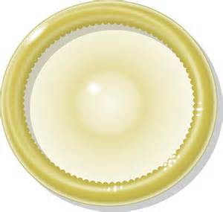
Unmet needs for
HIV prevention
2010 study in US on condom use found:
Men: 24% reported using a condom in last sex act
Women: 18% said male condom used in last sex
= condom NOT used by 3 in 4 men!
Why?
Decreased sensation. Decreased Pleasure. Intimacy. Connection. Emotion. Lust. Love.
Notes:
Since the 1980s, we have relied on condoms for HIV prevention. Male and female condoms are the only tools that can keep HIV from getting into the body during sex. But we have to look at the realities about when and how often people use condoms.
Here are the results from one survey of nearly 6000 heterosexual adults and adolescents. The survey asked whether they had used a male condom the last time they had vaginal sex. Among the men, 24% said they had used one. And 18% of the women said the man used one.³
Now, this survey includes a wide range of sexually active adults. Some of the people surveyed were likely faithful couples who saw no need for condoms. Or maybe they were trying to get pregnant. Or maybe they ran out of condoms.
But – besides all those reasons – it’s a fair bet that a lot of those people didn’t use condoms because they just don’t like them. Some say it takes away from their pleasure or that it suggests that they don’t trust each other. Some say it breaks the closeness and connection they want to feel during sex. Some men have problems keeping an erection when they use a male condom. This can happen to a man if he has been drinking alcohol or if he is a little older. People have all kinds of reasons for skipping the condom. That is one of the reasons we have 45,000 new HIV cases every year.
6

Slide 7
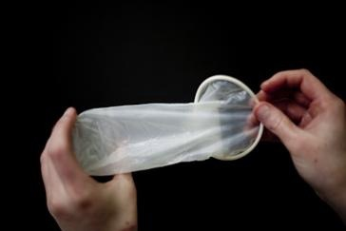
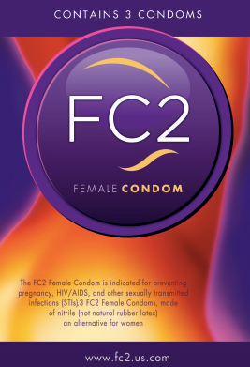
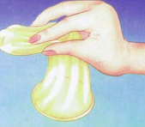
What about Female Condoms?
Great option.. not available everywhere…
cost 3- 4 X more
5
Notes:
So here is another choice -- the FC2. It is the only female condom sold in the US right now. In other countries, you can get a few other types of female – or internal – condoms. But those other models aren’t approved for sale in the US yet.
Female condoms are just as safe and effective as male condoms. The woman can insert it into her vagina any time before sex – whether it is several hours in advance or right at the last minute. Some people also use a female condom for anal sex.
The FC protects against pregnancy, HIV and other sexually transmitted infections (or STIs). The FC is also something a woman living with HIV can use if her partner is HIV negative or if she doesn’t know her partner’s status. It gives her a way to protect her partner from her HIV and also protect herself from getting another strain of HIV if her partner is HIV positive.
Some couples take turns -- using the male condom one time they have sex and then a female condom the next time. It is really helpful for people to have access to both options, so they have a choice about what they want to use. And many men say the FC doesn’t reduce their pleasure the way male condoms do sometimes. Some men really prefer FCs for that reason.
But the FC may not be as easy to get as male condoms are. When they aren’t on the shelves in your local store -- next to the male condoms -- ask why not!! Many store manager don’t think that women want FCs. So we need to start asking for them!
Right now, FCs cost three to four times more than male condoms do. Their price will probably come down when they are more popular and there is a bigger demand for them. Meanwhile, you may be able to get free female condoms from your local health department, in family planning clinics, from outreach workers or at HIV-related organizations. It’s worth looking around and asking if these providers to supply female condoms. For many women, they can be life-savers.
7

Slide 8
Imagine a whole tool box…
Before exposure
Point of transmission
After exposure
HIV counselling
& testing
Circumcision
PrEP
Treatment as prevention
Preventive vaccine
Condoms & lube
Preventing transmission to babies
Clean injecting equipment
Vaginal & rectal microbicides
Cervical barriers
Post-exposure prophylaxis (PEP)
Treatment as prevention
Therapeutic vaccines
Notes:
Let’s try looking at HIV prevention as a big toolbox. The tools in black already exist. The lighter ones are still being developed.
This column (point to “before exposure”) has tools designed to work ahead of time, like HIV counseling and testing. Being circumcised has no effect on a man’s chances of passing HIV during heterosexual sex, but it does reduce his risk of getting HIV from a woman by up to 60%! We’ll talk about PrEP in a minute. “Treatment as prevention” works because taking treatment when you have HIV lowers your HIV viral load and makes you less likely to pass it on. Work to develop a vaccine that prevents HIV is on-going. Someday, getting an HIV prevention shot may be as easy as getting a flu shot is now.
What protects us at the time of contact with HIV? Condoms and lubricants lead the list. Mothers living with HIV get treatment in pregnancy, childbirth and while breast-feeding to stop HIV from being passed to the baby. Clean syringes keep people from passing HIV on during drug use. Microbicides are gels, rings and other products are still being developed. These will be something you can insert before sex for protection. So are cervical barriers—like diaphragms or cervical caps—that could be used along with microbicides for extra protection.
Lastly, what can we use after contact with HIV. Post-exposure prophylaxis, or PEP, is something you can take after you have been exposed to HIV to prevent it from taking hold in your body. PEP is different from PrEP, which you take before you are exposed to HIV. PEP is usually prescribed after a rape or an accident like a needle-stick in a hospital. It can also be prescribed after a person is exposed during sex but it is more often used more as an emergency measure. And, finally, therapeutic vaccines are being developed to reduce the impact of HIV in the bodies for people living with HIV.
8

Slide 9
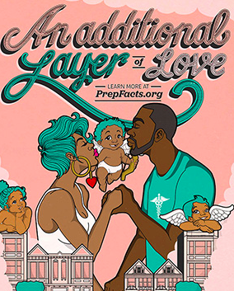
What drugs are used
for PrEP?
FDA approved: Truvada
= (tenofovir + emtricitabine combined)
  Easy to use: one pill per day
  Safe: Few side effects
  Stays in the bloodstream
  a long time
Notes:
In 2012, the US Food and Drug Administration ruled that Truvada (troo-VAH-dah) could be prescribed as PrEP to prevent HIV. They first approved Truvada back in 2004 as an anti-retroviral drug to treat people living with HIV. HIV is a retrovirus, so drugs fight HIV are called anti-retroviral drugs, or ARVs, for short.
When you have HIV, doctors prescribe a mix of ARVs to keep the virus under control in your body. One drug alone is not enough to do the job. As you see, Truvada is actually a mix of two ARV drugs--Tenofovir (tuh-NOF-uh-vĭr) and Emtricitibine (ĕm-truh-CIT-uh-bean).
If you are HIV negative, taking Truvada can really lower your risk of getting HIV if you are exposed to it. It stays in the blood stream long enough to protect you if you take one pill every day. We will talk about the side effects it may have in a minute.
Some other ARVs are being tested to see if they could work as well for PrEP as Truvada does. But none of those have been approved yet for use as PrEP -- so the only PrEP drug available right now is Truvada.
9

Slide 10
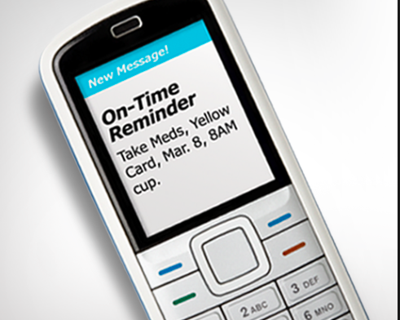
Effectiveness = taking it daily for now
can protect
up to 92%
if
taken daily
Notes:
Research has been done to see how well PrEP works to protect all kinds of people. Studies have enrolled men who have sex with men (MSM), cis-gender and transgender women and mixed status couples. These are couples where one partner is living with HIV and the other is not. The couples came to their study visits together and the HIV negative partners got PrEP.
Everyone enrolling in all the studies got free condoms. They were all urged to use the condoms and NOT to rely on the pills for protection because no one knew for sure if PrEP worked or not. Then half of the HIV negative participants got the real drug and the other half got a placebo (plah-SEE-bow), which is a fake pill. This way, the scientists could see if PrEP was effective by comparing what happened among those who got the real pills versus those who got the placebo pills. All participants were told that only half the group would get real pills. They agreed to be in the trial knowing they only had a 50:50 chance of getting PrEP.
It turned out that PrEP works very well WHEN people don’t forget to take it. People who took the pills every day had up to 92% less chance of getting HIV than those who did not take them at all.⁴ But getting that result really depended on not missing pills.
In a couples study: 4 out of 5 of the HIV negative partners took pills daily. As a result, most of them (3 out of 4) didn’t get HIV.
In an MSM study: About half the men took pills regularly. The group’s HIV risk went down, but less than it did for the couples.
In two studies of cis-gender women: Many women didn’t take the pills daily. The group’s overall HIV risk didn’t go down at all.
The Bottom Line is: The level of protection you get from PrEP depends on YOU -- and whether you take it daily or not.
10

Slide 11

What about side effects?
“Start up” reaction:
  nausea, vomiting, fatigue, dizziness
  1-2 weeks usually
In a few people:
  Blood tests may show changes in kidney function
  Also rare, slight change in bone hardness
  Both reverse when PrEP use is stopped
Notes:
Some people experience a short-term reaction when they start PrEP. They may have some nausea, fatigue, headaches –and maybe even some vomiting. These just happens while the body is getting used to the new drug. For most people, these side effects go away after the first week or two. If it doesn’t, you should check with your health care provider.
There are two major side effects that a very small number of people may get. The first is that PrEP can have an effect on kidney function. Part of the reason people on PrEP have to get regular check-ups is to look for this side effect. People who get it are taken off of PrEP right away.
The second major side effect is that the PrEP drug, Truvada, sometimes leads to very mild change in bone hardness. This can affect how strong your bones are. Again, people taking PrEP are tested for this during their follow-up visits. If tests show that bone hardness is changing, then the person is taken off of PrEP.
In both cases, the body goes back to normal as soon as the person stops taking PrEP. No long term damage is done either to the bones or the kidneys as a result of getting these side effects.
11

Slide 12



SUPER IMPORTANT
To build up to protective levels,
PrEP takes
20 days in vaginal tissue
but only 7 days in rectal tissue
20 days for
vaginal protection
7 days for
rectal protection
Notes:
This is one aspect of taking PrEP that women really need to know about.
With any drug, it only works when enough of it builds up in the right part of your body to make a difference. Let’s say your head hurts, for example. You don’t get relief the minute you swallow a headache pill, right? You have to wait for the drug to enter your blood stream and get to your head before you feel better.
With PrEP, the drug builds up over time in the vagina or the rectum. When it reaches an effective level, it can protect those tissues if they are exposed to HIV during sex. But getting to that level takes several days. If you take PrEP every day for seven days – the drug will build up to a protective level in the rectum. Then you have to keep taking it to maintain that protective level if you are having receptive anal sex.
But it takes longer to build up a protective level of drug in the vagina. Women have to take PrEP every day for 20 days to get protection during vaginal sex.⁵ This also means that women have to be EVEN MORE careful about not missing pills. After the first 20 days, a woman still has to be careful not to miss a day if she needs vaginal protection. Missing doses can cause the drug level in the vagina to drop. If it drops below the level she needs for full protection, her HIV risk could go up.
More research is being done to find out why the drug works this way. This gap between what is needed for rectal protection and what is needed for vaginal protection may also help explain why the PrEP studies enrolling women did not show effectiveness. It may have been partly because of this gap, and not just because the some of the women enrolled did not take their pills daily.
12

Slide 13


When transgender women choose to take PrEP
Will using
PrEP cause problems
with the
hormones I
am taking??
How much
would PrEP
cost?
How much do they know about how our transgender bodies will react?
Would they even prescribe PrEP for a woman like me?
Notes:
Transgender women have their own, unique questions about PrEP. Like everyone else, most of them want to know how much it will cost. They may also want to know how to find a provider who will prescribe it for them, if they want it. The news about how PrEP builds up in the rectal tissue is also important to transgender women who have sex with men.
But the question asked most often by transgender women is whether PrEP is likely to get in the way of the hormones they take. And we still don’t have an answer to that question. So far, it looks like taking cross-sex female hormones and using PrEP at the same time is not a problem. But more research needs to be done before we will know that for sure.
Some studies enrolling men who have sex with men have also enrolled transgender women who have sex with men. But very few transgender women stayed in these studies for more that a few visits. They dropped out because they didn’t feel comfortable in the study or for other reasons. So few of them stayed in these studies that the researchers did not learn enough about transgender women and PrEP to really tell us anything. We clearly need more information on how transgender women’s bodies react to PrEP and how they feel about using PrEP.
13

Slide 14
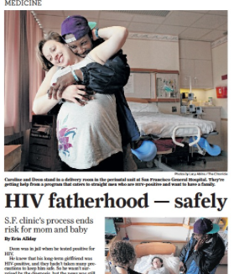
PrEP-ception
Notes:
Here is another group of women who may want to know about PrEP – women who want to get pregnant.
This picture was part of a recent newspaper report about PrEP-ception. That is a made-up word to describe how some woman can using PrEP while trying to get pregnant. In mixed status couples – with one HIV positive and one HIV negative partner – how do you get pregnant safely? Sex without a condom is risky. There are other options – like sperm-washing, which means taking HIV out of the semen -- or getting in vitro fertilization. These processes have to be done in laboratories. They are safe but they also cost a lot.
PrEP offers another choice. An HIV positive partner who takes ARVs every day has a low risk of passing HIV on to a partner. The HIV negative partner can further lower the risk of transmission by taking PrEP every day. Combining these two steps results in a very low chance of HIV transmission if the couple has sex without a condom. That’s PrEP-ception – a way for mixed status couples to get pregnant safely. Research has also shown that taking PrEP before and during pregnancy does not affect the baby.
PrEP-ception is a big help to couples like the one in this picture – who now have a lovely little daughter.
14

Slide 15
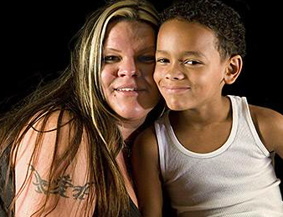
Sustainable Healthcare Implementation PrEP Pilot (SHIPP)
Demonstration Project:
    Can public clinics deliver PrEP effectively?
In Philadelphia, Chicago, Washington DC & Jackson MS
1200 participants are getting:
    Health care and treatment
    HIV and STI screening & prenatal care
    PrEP pills
    help in using PrEP correctly every day
Notes:
Another piece of really good news is that the first demonstration project on PrEP enrolling American women has started up. A demonstration project is something that happens after we know that a product is both safe and effective. It is done to figure out what is the best way to introduce the new product to people who need it. All the research done on PrEP in the US in the past was focused on men who have sex with men. But this demonstration project will show us more about the best ways to make PrEP available to American women, as well as men. It will also tell us more about how women feel about PrEP and what their concerns are.
SHIPP⁶ is a pilot study making PrEP available to women and men through community health centers in 4 cities – Philadelphia, Chicago, Washington DC, and Jackson, Mississippi. People coming to these health centers will get their normal health care. But they will also be offered PrEP if they have a medical history or concerns indicating that it might be useful for them. The purpose of this project is to see how much interest there is in using PrEP, how well people do with taking PrEP every day and how they feel about using it. If they want help remembering to take their pills, they can ask the clinic to call them, text them, or provide them with other daily reminders. But reminders are only for people who want them.
Results from the SHIPP Project are expected in 2017.
15

Slide 16
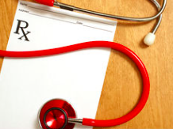
How do people get PrEP?
With a prescription, after being checked for:
  Negative HIV test
  No signs/symptoms of new HIV infection
  Normal kidney function
  No medicines that could interfer with PrEP
Also, check-ups every 3 months with:
  HIV test and STI screening
  pregnancy test
  checking for side effects
Notes:
You can only get PrEP if you have a prescription. The best way is to see a health care provider who is well informed about PrEP. She or he can help you decide if it is right for you. If you have health issues that could get worse if you take PrEP – like kidney problems or weak bones – it might not be right for you.
At the clinic, you will get an HIV test. They will also look to see if you have any symptoms of having gotten HIV very recently. This is because – if you start taking PrEP by mistake when you already have HIV -- your HIV could become resistant to Truvada. Resistance means the Truvada would no longer have any effect on your HIV. You would not be able to take it as part of your HIV treatment plan so you would have fewer treatment options.
People who want PrEP get tested for HIV right before they start on PrEP and every three months while they are taking it. They are also screened regularly for other STIs because PrEP does not protect against these.
They are tested to see if they have any kidney or bone strength problems. Women who take PrEP also get regular pregnancy tests. Most women can stay on PrEP if they are pregnant but they should talk to their doctor about this because every case is different.
The provider may also do a blood test to see if you are taking the your PrEP pills regularly. The clinic can help you think about ways to remind yourself to take them, if you need reminders.
16

Slide 17
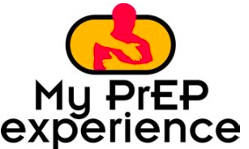
What does it cost?
Covered by: Insurance plans
        Medicaid
        Gilead’s Medication Assistance Program for pills
        some state & private groups help with co-pays & labs
        • Out-of-pocket cost: ~ $13,000 per year – very few pay that
“Insurance companies and Medicaid programs - so far - are covering the cost of Truvada as PrEP.”
From: Truvada Track
Online at: http://myprepexperience.blogspot.com/p//truvada-track.html
Notes:
One big question most people ask about PrEP is “who will pay for it”? Very few people can afford the $13,000 per year it costs to pay for it out of pocket.
So far, the insurance companies and Medical Assistance (Medicaid) have been willing to pay for PrEP. In the long run, it costs them less to pay for HIV prevention (such as PrEP) than it does for them to pay for HIV treatment.
Sometimes insurance plans require you to pay for co-pays or for the screening tests you may need to get PrEP. You may be able to get help with these costs through Gilead, the company that makes Truvada. Staff at the clinics that prescribe PrEP can often help you find ways to get costs covered and guide you through the paper work you need to do to get this. Your local HIV service organization may also be able to help you work through this process.
There is also a group of advocates who run “Truvada Track”. It is an online service that is watching to see if people are having problems with PrEP costs. In April 2015, it published this statement (Speaker: read statement in orange on slide).
If you have trouble getting your PrEP paid for, contact Truvada Track for help. Their mission is to make sure that people who want and need PrEP can get it.
17

Slide 18

Truvada as PrEP
is the first HIV
prevention tool that can be
fully controlled by the
receptive sex partner
Notes:
Since we first learned about HIV in the 1980s, women have had a harder time protecting themselves from it than men have. In most couples, women don’t control condom use. Men do. And in many households, women can’t control when and how sex is going to happen. Men do. Female condoms are a big help but most men can tell when their partner is using one. So it is still something that partners have to talk about.
For over thirty years, cis-gender and transgender women – along with men who are receptive sex partners -- have been calling for tools that we can use on our own to protect ourselves from HIV.
Now we have PrEP – the first HIV prevention tool that women and men who have receptive sex can control on their own. If a woman can take PrEP, privately, every day, she can really reduce her HIV risk.
For the first time, we don’t need a man’s or anyone’s consent or cooperation to protect ourselves. As one woman put it, “we don’t have to ask permission to save our own lives.”
PrEP is not for everyone. But it is a much needed option for some of us. That’s why we think every woman deserves to know about it --- and to have access to it if she wants it.
18

Slide 19
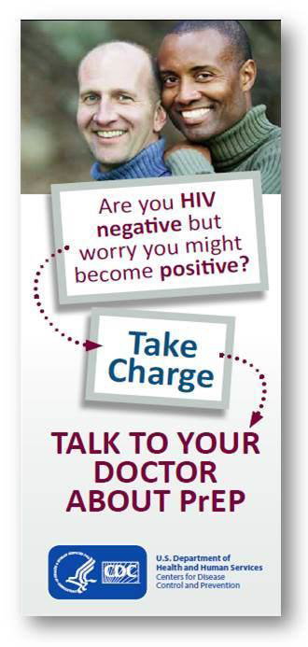
Talking to your health care provider about PrEP
Designed to help people talk to their doctors about PrEP
Good to read before, during, and after a visit
Includes questions to ask
Locates web resources
Get it from CDC.gov at
www.cdc,giv/hiv/pdf/risk_PrEP_
TalkingtoDr.pdf
Notes:
For people interested in PrEP, it is good to get some printed information before going to a doctor or clinic about it. Since PrEP is fairly new, some providers don’t know much about it. If they are not well-informed, they may discourage you from asking about PrEP so they don’t have to respond to your questions. Having this brochure on hand can help you deal with that.
Published by the CDC, it is something you can share with a provider. It is also good to read on your own, to prepare for your visit. The fact that two men are on the cover doesn’t mean this piece is only for men. It also applies to women. You can download copies of this brochure online for free.
If your health care provider does not know much about PrEP, find another provider who knows more about it. It is a good idea to call your local HIV service organization or your local health department and ask them for the names of doctors who prescribe PrEP. Often LGBT rights organizations can also refer you health care providers for this.
(Speaker: Please feel free to add your own comments here about how people can access PrEP in your community.
If you do not have that information, suggest that they look at the info. sources on next slide.)
19

Slide 20
More PrEP Resources & Thank You!
PrEP Support Hotline for Clinicians:
1-855-448-7737 (1-855-HIV-PREP)
To contact the US Women and PrEP Working Group: uswomenprepworkinggroup@gmail.com
  For a great booklet on women and PrEP, go to http://www.projectinform.org/pdf/prep_women.pdf
  Other websites:
    http://www.sisterlove.org/us-women-prep-working-group/
  www.prepwatch.org
  http://www.hiveonline.org/for-you/
  myprepexperience.blogspot.com
  www.prepfacts.org
Notes:
(Speaker: Please leave this slide up now while you do the “Questions and Answers.” This gives people time to copy the information here if they need to.)
Thank you for your coming to this presentation. I hope you got some useful information from it. I am going to leave this slide up during our “Question and Answer” time in case you want to copy any of this down.
The PrEP Support Hotline here (point to top of the list) is for doctors and other health care providers. You can give the number to your doctor as a source of more information on PrEP, if you want to.
Most of the information we discussed today comes from the Centers for Disease Control and Prevention. It is the part of our government that deals with the country’s health care status and needs. Most doctors and researchers agree that news put out by the CDC is accurate. These other websites also have information you can trust.
I hope you will share the information you got today with other people. The more people know, the better they can protect themselves from HIV. The more people protect themselves, the sooner we will see the number of people getting HIV go down. Now, who has a question for me?
20

Slide 21
Citations
On slide 5
  1. Frieden TR, Foti KE, Mermin JO..Applying public health principles to the HIV epidemic: How are we doing? New England Journal of Medicine 2015; 373;23. Available from: http://www.nejm.org/doi/full/10.1056/NEJMms1513641
  2. Kaiser Family Foundation. Women and HIV/AIDS in the US. 6 March 2015. [Online] Available from: http://kff.org/hivaids/fact-sheet/women-and-hivaids-in-the-united-states/
On slide 6
  3. Reece M, Herbenick D, Schick V, Sanders SA, Dodge B, Fortenberry JD. Condom use rates in a national probability sample of males and females ages 14 to 94 in the United States. Journal of Sexual Medicine 2010; Suppl 5:266–76. Available from: http://www.ncbi.nlm.nih.gov/pubmed/21029384
On slide 10
  4. AIDS.gov. Pre-Exposure Prophylaxis (PrEP). [Online]. Available from https://www.aids.gov/hiv-aids-basics/prevention/reduce-your-risk/pre-exposure-prophylaxis/
On slide 12:
  5. Highleyman L. Study Suggests Truvada PrEP Should Start 1 Week Before and Continue 4 Weeks After Sex. HIVandHepatitis.com. 2015 May 6; Available from http://www.hivandhepatitis.com/hiv-prevention/hiv-prep/5169-study-suggests-truvada-prep-should-start-1-week-before-and-continue-4-weeks-after-sex
On slide 15:
  ClinicalTrials.gov. Sustainable Healthcenter Implementation PrEP Pilot Study (SHIPP). [Online]. Available from: https://clinicaltrials.gov/ct2/show/NCT02074891
Funded by Gilead Sciences
Notes:
21

