Slide 1
Dapivirine Ring 101
The dapivirine vaginal ring for HIV prevention
Updated July 2020

Slide 2


What is the dapivirine vaginal ring?
An ADDITIONAL, woman-initiated
HIV* prevention option that received a positive scientific opinion in July 2020 for use by women ages 18 and older from the European Medicines Agency** (EMA), a stringent regulatory authority.
The dapivirine ring is a flexible vaginal ring made of silicone that slowly releases an antiretroviral (ARV) drug called dapivirine over the course of one month to reduce the risk of HIV-1 infection.
The ring was developed by the nonprofit International Partnership for Microbicides (IPM).
Notes:
*The dapivirine ring reduces the risk of HIV-1 infection.
**The EMA is a decentralized agency of the European Union (EU), responsible for the scientific evaluation, supervision, and safety monitoring of medicines in the EU.

Slide 3
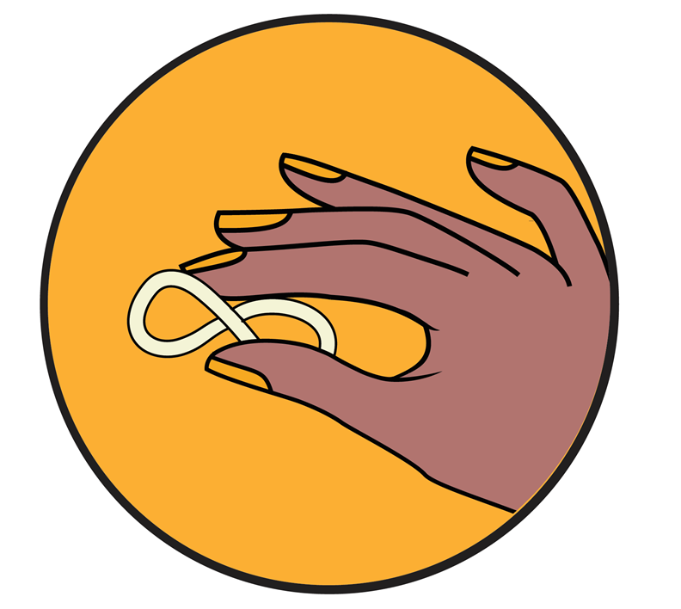
More about vaginal rings
Vaginal rings are small, flexible plastic rings that are inserted into the vagina to release different drugs help achieve sexual and reproductive health goals, including contraception, hormone management, and HIV prevention.
Vaginal rings are already used successfully in many countries to deliver contraception.

Slide 4
Why the dapivirine vaginal ring?
No safety concerns in clinical trials to date
Shown to reduce HIV risk in clinical trials
Easy to use
Long-acting
Private

Slide 5
The dapivirine vaginal ring: safety
No safety concerns related to dapivirine ring use have been identified in previous trials
The ring delivers dapivirine locally in the vagina where infection could occur, and little of the drug is absorbed elsewhere in the body
  Data from the Phase III studies show no evidence that the ring increases resistance to NNRTIs* or interferes with treatment response among women who became HIV-positive during clinical trials
  Mild side effects: some women in clinical trials experienced mild to moderate urinary tract issues, vaginal discharge or itching, but these usually went away within a week or two
*NNRTIs are non-nucleoside reverse-transcriptase inhibitors, a type of HIV drug
Notes:
There have been more than 30 clinical studies of the dapivirine vaginal ring, including two Phase III trials and two open-label extension trials

Slide 6
The dapivirine vaginal ring: safety
The ring can be used with most family planning methods
An ongoing open-label study among pregnant women is collecting additional safety data about ring use during pregnancy
An additional study is planned to assess safety of ring use while breastfeeding
Notes:
Women who became pregnant while using the ring during clinical trials were taken off product.

Slide 7
The dapivirine vaginal ring: efficacy
The ring reduced the risk of HIV-1 infection by 35% in The Ring Study and by 27% in the ASPIRE study
In addition, recent open label studies showed greater adherence to the ring and modeling data suggest that HIV risk is reduced by about 50%
Increased ring use was associated with greater HIV risk reduction!

Slide 8
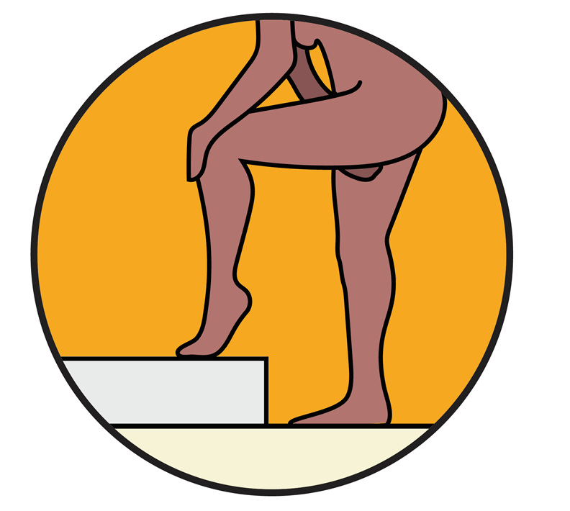
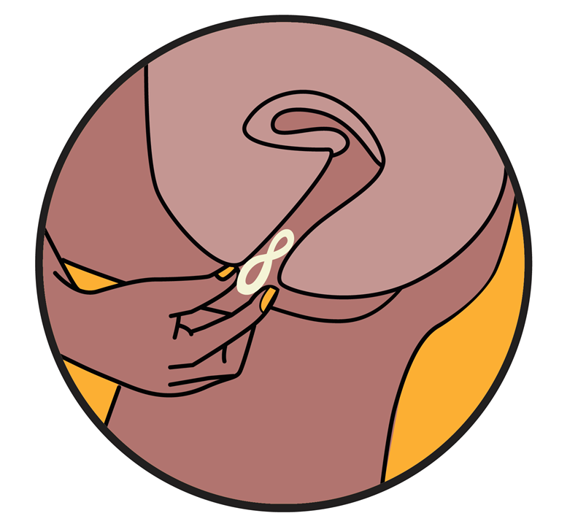
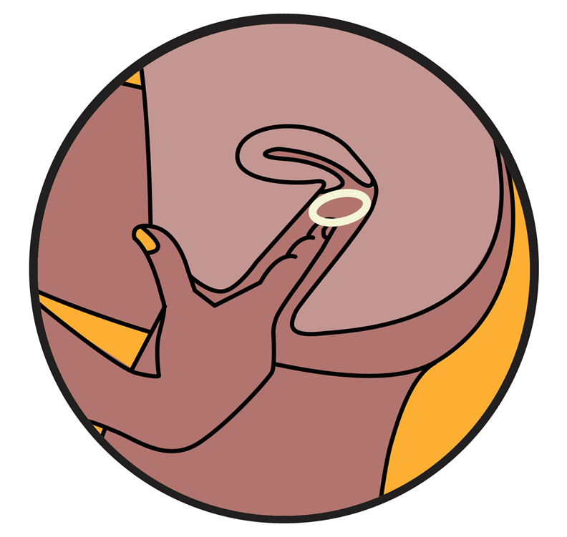
Dapivirine vaginal ring: ease of use
Women can insert and remove the ring themselves, if they prefer, with little or no support from a health care provider.
Ring insertion and placement
Guidelines about ring use (such as what kinds of regular testing is needed to use the ring, and whether a ring can be prescribed by a nurse or clinician) will be determined by each country*
Notes:
*The World Health Organization (WHO) will also issue guidelines on ring use

Slide 9
Dapivirine vaginal ring: ease of use
The ring can be inserted by women without help from a health care provider
  A health care provider may insert the first ring, if wanted, to ensure that the woman is familiar with how the ring should be inserted
The majority of women in clinical trials reported that the ring didn’t interfere with their daily activities

Slide 10
The dapivirine vaginal ring: long-acting
The dapivirine ring provides steady release of drug over one month without the need for maintenance
Low maintenance means less burden on the user to remember doses, and may encourage more consistent use
Notes:
Although the ring should be used consistently – that means is should be kept inside the vagina for the entire month of use - the ring does not have any visual indicators to show that dapivirine is being released.

Slide 11
The dapivirine vaginal ring: privacy
The ring can be stored, inserted, and removed in private
During clinical trials, it was rarely felt by women or male partners
  Most women in clinical trials reported that they could not feel the ring when it was inserted correctly
  Many women in clinical trials reported that they and their partners could not feel the ring during sex

Slide 12
What are women saying about the ring?
Women in studies report…
I like that the ring stays inside you and nobody can see it…. you don’t have to disclose ring use to others if you want. My family doesn’t know that I am using the ring. … And the partner can’t feel it as well. ¹
It wasn’t difficult, I got enough education before using it because I was really scared when I first saw it… But during education I learned that the ring was soft, I thought the ring was hard and painful. They showed that to insert the ring you need to twist it like 8 and when I tried it, it was easy and doable.” ¹
I don’t feel the ring when it is inside me, I only feel it during insertion. I don’t feel it though when I’m seated or walking. The ring has never fallen; it’s not painful… the ring is not felt when you are walking or sleeping; it doesn’t even move²
Notes:
Quotes
(1) Montgomery ET, van der Straten A, Chitukuta M, et al. Acceptability and use of a dapivirine vaginal ring in a phase III trial. Aids. May 15 2017; 31(8): 1159-1167.
(2) MTN-020 Qualitative IPM Report, April 2017

Slide 13
Adding the ring to the HIV prevention toolbox
People’s preferences and needs are not all the same – and preferences change over time!
For example, women regularly weigh side effects, life stage, and “medicalization” when making contraceptive choices.
Products must be used in order to reduce HIV risk.
The ring presents an additional option for women who want to protect themselves from HIV. As the family planning field has shown, more options can lead to higher uptake of prevention methods overall.

Slide 14



Ongoing & upcoming trials
Further trials are planned and underway to gather more data on the safety of ring use during adolescence, pregnancy, and breastfeeding
Notes:
For more information on completed, ongoing, and upcoming trials, visit www.mtnstopshiv.org and www.ipmglobal.org

Slide 15

Ring clinical trials: What is next?
Long-acting rings that can be worn for up to 90 days
Multipurpose rings with dapivirine or other antiretrovirals that prevent HIV, plus additional medications to prevent STIs and/or unwanted pregnancy. Multi-purpose technologies will help meet women’s needs, increase synergy of family planning and HIV prevention services, and reduce barriers to acceptability and access.
Pending trial results and regulatory approvals, it would still be several years before these rings are available to the public.
While these products and other HIV prevention technologies are still in development, the monthly dapivirine vaginal ring will help pave the way for their introduction!

Slide 16









Thank you
For more information on the dapivirine ring, visit:
https://www.ipmglobal.org/our-work/our-products/dapivirine-ring
https://www.prepwatch.org/nextgen-prep/dapivirine-vaginal-ring
https://mtnstopshiv.org
This program is made possible by the generous assistance from the American people through the U.S. Agency for International Development (USAID) in partnership with PEPFAR under the terms of Cooperative Agreement No. AID-OAA-A-15-00035. The contents do not necessarily reflect the views of USAID or the United States Government.
OPTIONS Consortium Partners

