Slide 1
Dapivirine Vaginal Ring (“the ring”)
An additional, user-controlled HIV* prevention option for those who cannot or choose not to use oral PrEP
Notes:
*The ring provides protection from HIV-1 infection.

Slide 2
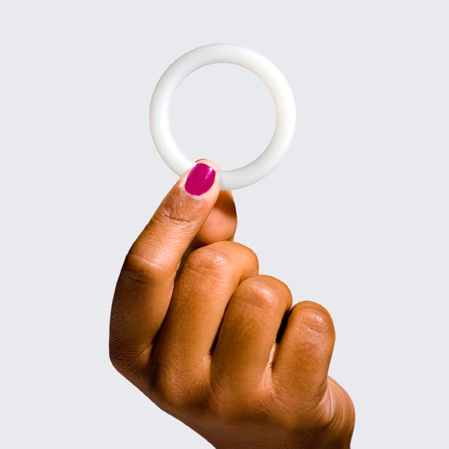
What is the Dapivirine Ring?
Flexible, one-size-fits-all vaginal ring developed by the International Partnership for Microbicides (IPM)
Slowly releases an anti-retroviral (ARV) called dapivirine into the vagina over the period of one month
The first long-acting HIV prevention product
User-controlled HIV prevention method

Slide 3
The Ring Fills Gaps in the Current Portfolio
 | Current options |  |  | Innovation
 | Condoms | Treatment as Prevention | Oral PrEP | Dapivirine Ring
Frequency | At time of sex | Daily | Daily | Monthly
Site of action | Non-systemic | Systemic | Systemic | Non-systemic
Role of male partner in use | Male partner consent required | Controlled by partner living with HIV | User-initiated | User-initiated

Slide 4
The Ring: Rollout Milestones as of March 2021
Positive Opinion:
European Medicines Agency
July 2020
Recommendation:
World Health Organization
January 2021
Inclusion in HIV Prevention Guidelines:
World Health Organization
March 2021
Added to prequalification list:
World Health Organization
November 2020
The World Health Organization recommends that the ring be offered as an option for women in need of HIV prevention methods as part of combination prevention approaches.
IPM has applied for regulatory approval in many countries, including the United States and South Africa. Some countries have already approved the ring, and more country regulatory responses are anticipated in 2021 and 2022.

Slide 5
Notes:
Note: In the HOPE Open-Label Study, participants were able to choose whether they would use the ring, and the HIV risk calculations include all participants – those who did and did not use the ring. This is the reason for the difference in estimated HIV risk reduction between HOPE and DREAM.

Slide 6
The Ring: Efficacy
The ring is clinically shown to reduce the risk of HIV-1 acquisition by about 30%
In addition, recent open label studies suggest that the chance of acquiring HIV is reduced by about 50% with consistent use of the ring
Consistent Use = Increased
HIV Risk Reduction!

Slide 7
The Ring: Safety
No safety concerns related to ring use have been identified in previous and ongoing trials
The ring delivers dapivirine in the location where exposure to HIV is likely to occur, so less of the drug is absorbed in the rest of the body
The Phase III clinical trials did not indicate ARV resistance associated with use of the dapivirine ring, or interference with antiretroviral therapy (ART) effectiveness in those women who became HIV-positive while participating in the trials
Minimal side effects – some women in clinical trials experienced mild vaginal discharge or itching, but these usually went away within a week or two

Slide 8
The Ring: Safety
It can be used with most family planning methods
Information from multiple studies has shown no safety concerns to ring users or their infants as a result of brief use of the ring in early and late pregnancy.
A small study of breastmilk among ring users who had weaned their infants showed no safety concerns and indicated that only very small amounts of dapivirine got into breastmilk.
Studies to confirm the safety of the ring during all stages of pregnancy and breastfeeding are ongoing.

Slide 9
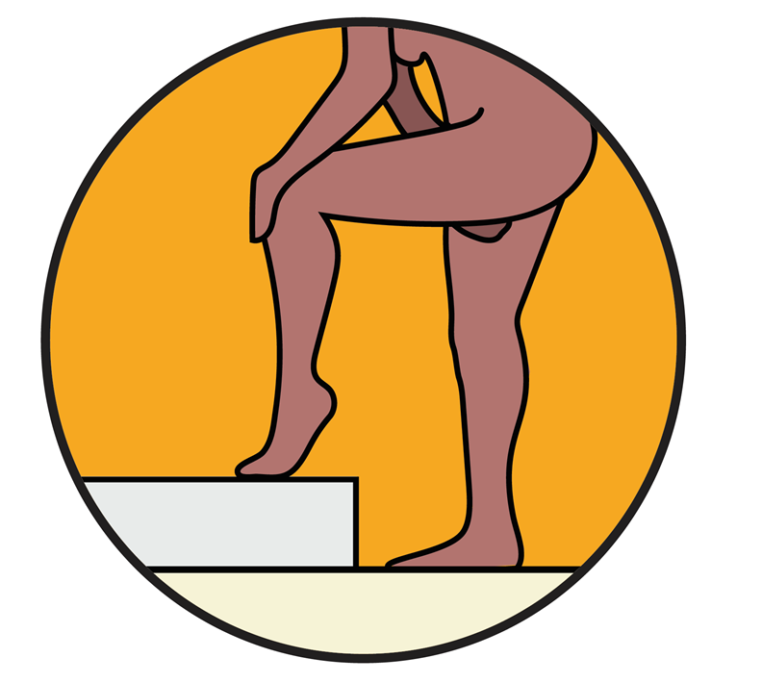
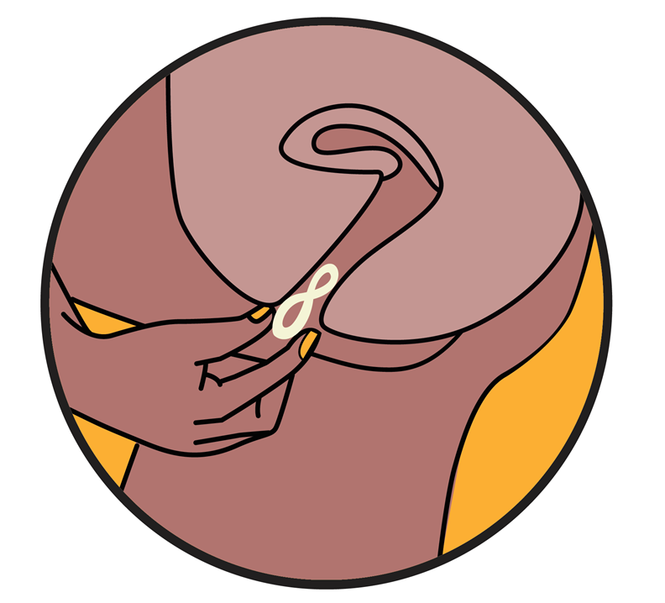
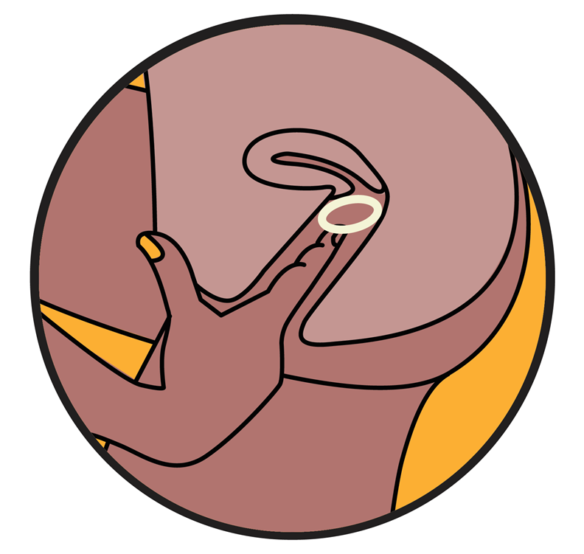
The Ring Insertion and Placement
Users can insert and remove the ring themselves with little or no support from a health care provider.

Slide 10
The Ring: Ease of Use
The ring can be inserted without help from a health care provider
A health care provider may insert the first ring, if wanted, to ensure that the user is familiar with how the ring should be inserted
Studies have found that the ring has little to no impact on sexual activity – many women and their partners reported that they could not feel the ring during sex

Slide 11
The Ring: Long-Acting
The dapivirine ring provides steady release of drug over one month without the need for maintenance
Low maintenance means less burden on the user to remember doses, and may encourage more consistent use

Slide 12
The Ring: Privacy
The ring can be inserted and removed in private
During clinical trials, it was rarely felt by women or male partners
Most women in clinical trials reported that they could not feel the ring when it was inserted correctly
Many women in clinical trials reported that they and their partners could not feel the ring during sex

Slide 13
What did women have to say?
Study participants report…
I like that the ring stays inside you and nobody can see it…. you don’t have to disclose ring use to others if you want. My family doesn’t know that I am using the ring. … And the partner can’t feel it as well. ¹
It wasn’t difficult, I got enough education before using it because I was really scared when I first saw it… But during education I learned that the ring was soft, I thought the ring was hard and painful. They showed that to insert the ring you need to twist it like 8 and when I tried it, it was easy and doable.” ¹
I don’t feel the ring when it is inside me, I only feel it during insertion. I don’t feel it though when I’m seated or walking. The ring has never fallen; it’s not painful… the ring is not felt when you are walking or sleeping; it doesn’t even move²

Slide 14
Potential Public Health Impact
Modeling data show that:
A range of prevention options alongside scaled-up treatment is needed to achieve epidemic control
Prevention methods with even modest efficacy would have a meaningful impact as part of a comprehensive strategy that could avert millions of HIV infections over time
The ring would prevent acquisitions among women that would otherwise not be averted by any other method
New, user-centered options like the ring will be crucial to achieving epidemic control

Slide 15
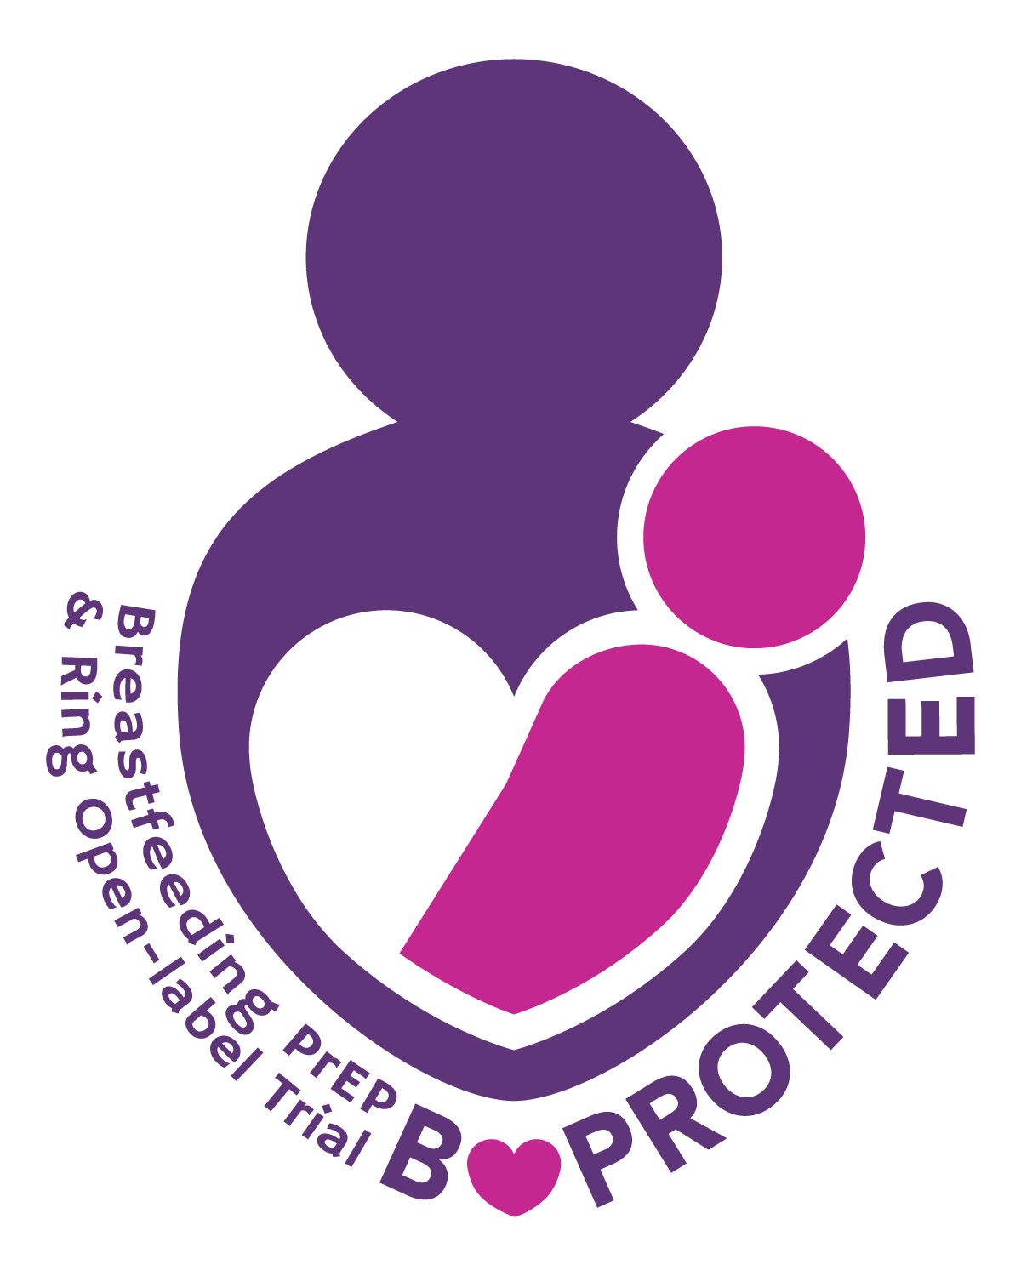
Ongoing Trials
Further trials are underway to gather more data on the safety of ring use during adolescence, pregnancy, and breastfeeding
Research is in progress on a 3-month Dapivirine Ring and a Phase 1 study that includes dapivirine or HIV prevention and levonorgesrel for contraception.

