Slide 1
How prototypes for IEC/Demand Generation materials were developed using an “HCD-Lite” approach: PrEP for Pregnant and Breastfeeding Populations
Manya Dotson & Polo Motsoari

Slide 2
Objectives of this Deck
This slide deck provides an overview of CHOICE’s experience developing demand generation resources to expand use of PrEP by Pregnant and Breastfeeding Populations (PBFP)
These slides provide context and background on how the initial prototypes were developed in collaboration with PBFP
This is intended to complement the “PrEP for PBFP Prototype Testing Guide” also available on PrEPWatch

Slide 3
Why have communications materials? Before starting we looked at what the materials need to achieve: Creating demand for PrEP among PBFP and supporting them to successfully use PrEP
Help PBFP succeed with PrEP
Need to Know
How to take/use medications
Drug interactions/risks
Side effects they might experience
When to seek help from a healthcare provider
Want to Know
Specific concerns, common questions
Where to get more information
Other Support
Help with adherence
Help with managing social dynamics
Other?
Create Demand for PrEP
Inspire or persuade PBFP to try PrEP
Build awareness, acceptance, desire

Slide 4
Create demand for PrEP among PBFP
Build awareness
Increase acceptance
Awaken Desire
Support adherence and persistence
Women are aware of elevated risk of HIV infection in pregnancy
Women are aware there is a way to prevent HIV infection they can control by themselves
Women trust that PrEP is safe for themselves, their babies, and women like them
Women trust that PrEP will not have any long-term effects on fertility
PBFP are motivated to try PrEP
PBFP see emotional and functional benefits that outweigh drawbacks
PBFP believe they can get their partners’ support
PBFP are able to persist through side effects
PBFP are able to gain social support
PBFP remember to take the pill daily
PBFP are able to restart if they forget pill(s)
Notes:
Being aware of something, accepting it, and desiring it, and using it effectively are different things. We broke down each of these elements, and considered from the PBFP’s perspective what would achieve each of these outcomes.

Slide 5
Our approach: From prototype to waiting room
Understand:
Lit review
Clinical Trial Focus Groups
Implementation research in SA
Any existing materials
Make:
Mock Ups
Use Canva.com
Mock up Different concepts
Apply the evidence
Test:
Get Feedback
Show to real PBFP waiting at clinics
Provoke open discussion
Listen for quotes and insights
Evolve
Revise and update as you continue to learn

Slide 6
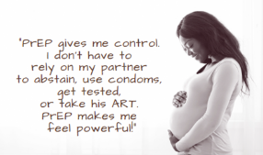
Understand: Literature review
What the evidence says:
Women want to take PrEP because…
Their partners unknown status and risky behavior
To protect their babies from HIV
PBFP have fears about…
Quality of breastmilk
Safety of the baby
Future infertility
Negative side effects (weight loss, etc.)
Women Persist and Adhere when…
They get SMS reminders
They get social support from friends, family, partner
“Even if you sleep with your partner without protection [condoms] or if you don’t know what he is up to, if you use PrEP, you know you are safe. That is the main reason that made me take PrEP… He loves girls; he is not trustworthy.”

Slide 7
Make: First draft mockups
We addressed insights revealed through published papers to create various prototypes/ concepts using Canva.com

Slide 8
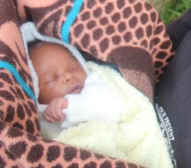
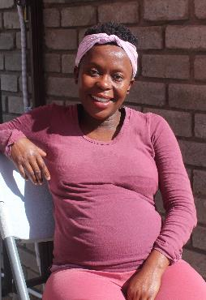
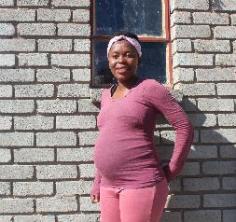
Test: Our Feedback Process: Date: 26 & 27 April Location: Maseru- government and private facilities, in waiting rooms No of women: 20, all pregnant or breastfeeding Objective: Unfiltered reaction to IEC concepts
Notes:
Hlalefang Motsoari
Hlalefang Motsoari is a 24-year-old young woman who stays in Maseru the capital city of Lesotho. She is currently 7 months pregnant. Since 2019, Hlalefang started using PrEP when they decided to exclusively date each other with her current boyfriend.
Even though they had agreed to be exclusive, she didn’t really trust her boyfriend, she was hesitant to become intimate without protection, so she decided to take PrEP to avoid the possibility of HIV infection.
She shared that at first, her boyfriend was not happy with her decision but because he wasn’t ready to get tested and know his HIV status, she managed to convince him and she has not stopped taking PrEP daily.
Now that I am pregnant and still of PrEP I feel safe. It makes me happy and proud that my unborn baby is protected too. Using PrEP during pregnancy has not had any bad side effects; I feel healthy and happy’ the cheerful Halefang said.
Baholo Shelile
Baholo Shelile lives in Berea 45 minutes away from Maseru. 7 days ago, she gave birth to a bubbly healthy baby boy- Katleho. Bahalo is 27 years old and has been married for almost 3 years.
She started using PrEP in early 2020 after hearing of its benefits from a Jhpiego Volunteer Community Advocate. After sharing the benefits of using PrEP with her husband who had always been very open about his status-, they decided she should use PrEP to protect her and the baby
they were planning to have. This is because; they would have to stop using protection during their sexual encounter.
Baholo said “I am taking PrEP and my baby is beautiful. PrEP has not affected or changed the amount or quantity of my breast milk and I am breastfeeding normally. My husband and I are very happy that we made a decision to protect our son. I’ am safe my son is safe too.

Slide 9
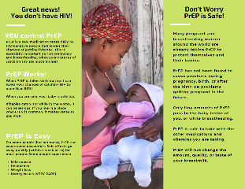
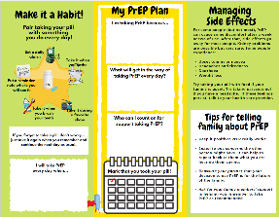
Test: What we Learned
Women were concerned about any messages that might stigmatize people living with HIV (e.g. We don’t want HIV!)
Everyone liked the baby
Wanted a phone number to call for more clarity
The free stock images are perceived to be relatable
Appropriate information about PrEP easy to understand
Knowing that PrEP is used around the world is reassuring
PrEP is safe to take with other medication is reassuring
Site effects concerning:
loss of weight while one is pregnant or breast feeding- discouraging
PrEP causing kidney issues- scary
Liked the calendar and plan
Were not sure if they would write on the paper, but thought it was good ot make a plan
Found the tips about talking to family about PrEP to be helpful

Slide 10
Evolve
Consider stigma- Change the title
Keep the Baby
Include phone #
Change the color to pink
Phone # here

Slide 11
Key Takeaways
Pregnant and breastfeeding populations need targeted information on PrEP
Localized information and pictures are key for acceptance (but these were stock images, which can be used for free and were perceived to be local)
Awareness of PrEP not enough to inspire desire and support persistence and adherence
Clients want help talking with partners/family members

Slide 12
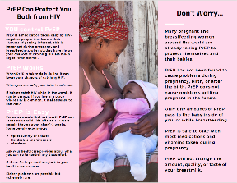
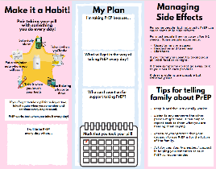
Trifolds to hand out
Additional Prototypes
Posters to hang in health facilities
Two-sided flyers to laminate for clinic waiting areas
Notes:
Available on PrEPWatch along with the PrEP for PBFP Demand Generation Prototype Testing Guide

Slide 13
References
Davey DJ et al. High initiation and persistence on PrEP in HIV-uninfected pregnant women in Cape Town, South Africa. HIV Research for Prevention (HIVR4P) virtual conference, abstract OA07.05LB, 2021.
Davey DJ et al. Partner support, disclosure and side effects: Facilitators of high maternal PrEP adherence in Cape Town. HIV Research for Prevention (HIVR4P) virtual conference, abstract OA21.05LB, 2021.
Flax, Valerie L., et al. "After their wives have delivered, a lot of men like going out: Perceptions of HIV transmission risk and support for HIV prevention methods during breastfeeding in sub‐Saharan Africa." Maternal & child nutrition 17.2 (2021): e13120.
Van der Straten A, Ryan JH, Reddy K, Etima J, Taulo F, Mutero P, Taylor J, Piper J, Musara P; MTN-041/MAMMA Study Team. Influences on willingness to use vaginal or oral HIV PrEP during pregnancy and breastfeeding in Africa: the multisite MAMMA study. J Int AIDS Soc. 2020 Jun;23(6):e25536. doi: 10.1002/jia2.25536. PMID: 32524700; PMCID: PMC7287313.

Slide 14
Thank you!
CHOICE Partners
This collaboration is made possible by the generous support of the American people through the U.S. Agency for International Development (USAID) and the U.S. President’s Emergency Plan for AIDS Relief (PEPFAR) through the terms of cooperative agreement 7200AA19CA00002 and 7200AA19CA00003. The contents are the responsibility of the EpiC project and the RISE project and do not necessarily reflect the views of USAID, PEPFAR, or the U.S. Government.

