Slide 1

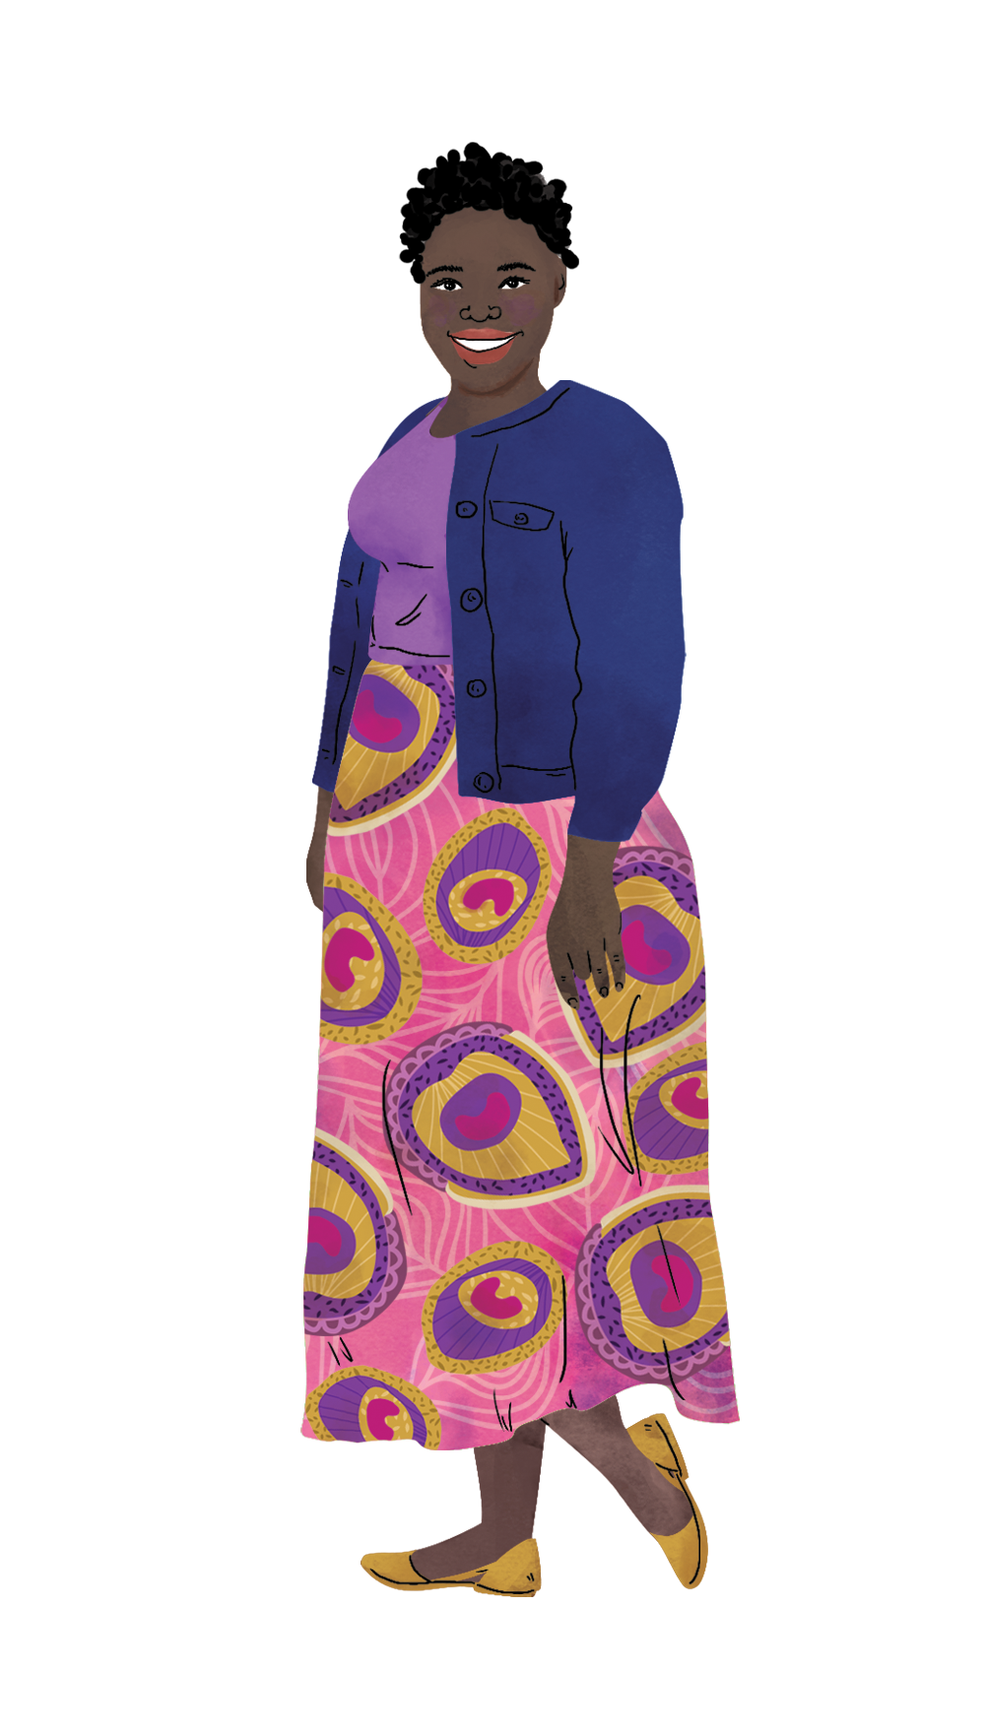
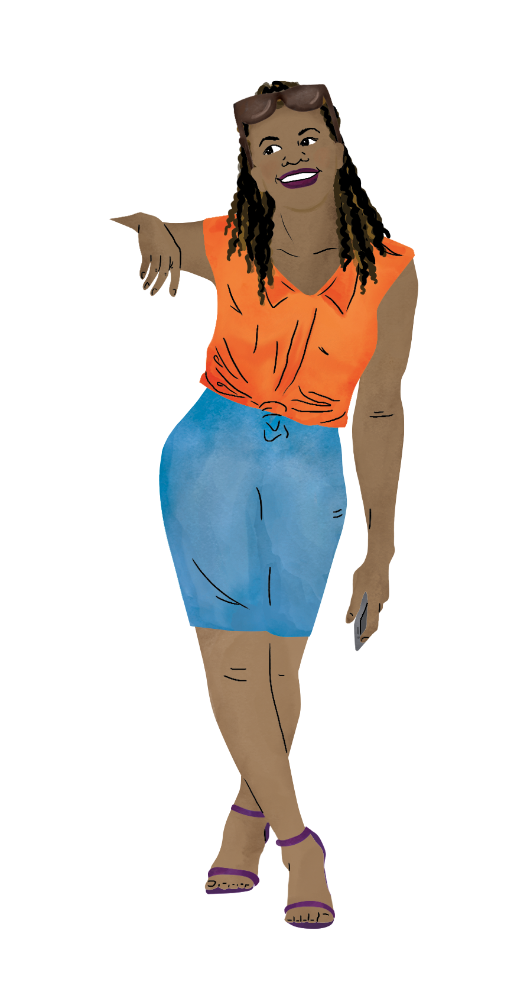
DAY
01
HIV Prevention Ambassador Trainers’ Workshop:
HOW TO ENGAGE ADOLESCENT GIRLS AND YOUNG WOMEN
AS ADVOCATES IN THEIR COMMUNITIES
VIRTUAL TRAINING OF TRAINERS
DAY OF THE WEEK | DD Month YYYY
Notes:
Add the date of Day 1 on this slide.

Slide 2
Learning Objectives
By the end of this workshop, HIV Prevention Ambassador trainers will be able to:
1 | Teach HIV Prevention Ambassadors how to provide their peers with detailed, accurate information about oral PrEP as part of combination HIV prevention approaches and address peers’ questions and concerns using the HIV Prevention Ambassador Training curriculum.
2 | Provide HIV Prevention Ambassadors with information and job aids to support their peers to make informed decisions, access oral PrEP, use it correctly, continue using PrEP while they are vulnerable to HIV, and tell others about their oral PrEP use.
3 | Support HIV Prevention Ambassadors to raise awareness and build community support for oral PrEP.
4 | Demonstrate competence in delivering commonly used training methods – such as brainstorming, case studies, role-playing, processing/process checks, and practice sessions or teach backs – and using appropriate levels of intervention when managing difficult training situations, including disruptive learner behaviors.
5 | Initiate a personal plan of action to strengthen training and facilitation skills.

Slide 3

Today’s Facilitators
Name
Title
Organization, Country
Name
Title
Organization, Country
Name
Title
Organization, Country
Notes:
Right-click on each circle and select Change Graphic. Then, select From a File. Use this process to upload photos of each designated facilitator.

Slide 4

Day 1 Agenda
Time | Session | Facilitator
15 minutes | Welcome | NAME
5 minutes | Training Introduction | NAME
30 minutes | Facilitator Preparation | NAME
10 minutes | BREAK
20 minutes | Ambassador Skills | NAME
35 minutes | Activity: Case Study | NAME
5 minutes | Homework | NAME
30 minutes | Activity: Mentorship Teams | ALL MENTORS
Notes:
Add in the appropriate details, including timing of sessions and designated facilitators.

Slide 5
Icebreakers

Slide 6

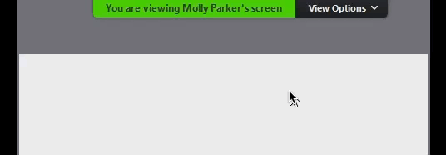


How-To Annotate
At the top of your Zoom screen, choose View Options, then Annotate.
Throughout this training, we will use the Stamp and Text features.
These are the Stamp icons you can choose from.

Slide 7

How are you feeling today?
Notes:
Annotation: Stamp

Slide 8
As a child, what profession did you hope to have when you grew up?
Notes:
Annotation: Text

Slide 9
Training
Introduction

Slide 10

Why this training?
THIS WEEK’S WORKSHOP
Notes:
Explain that this training is a workshop for HIV Prevention Ambassador trainers that builds on the information provided in the HIV Prevention Ambassador Training Package and Toolkit. As noted in the facilitation plan, participants are required to read the HIV Prevention Ambassador Training Package and Toolkit prior to Day 1.
Suggestion: Share specifics about the cohort of participants. What do you hope participants walk away with after this training?

Slide 11
Facilitator
Preparation
Notes:
This section covers Facilitator Preparation, with specific focus on how to identify HIV Prevention Ambassadors and how to prepare for training them.

Slide 12
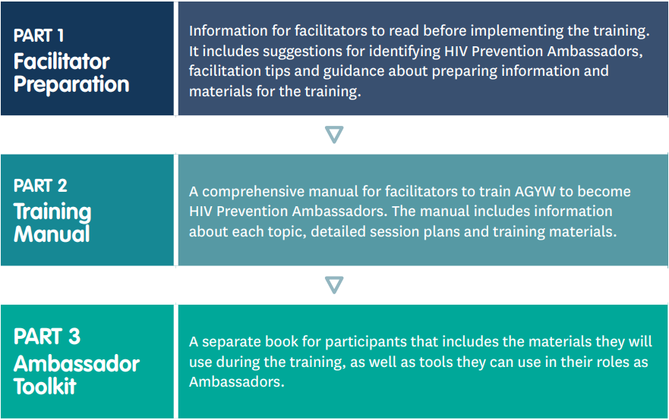


Slide 13
Identifying
HIV Prevention
Ambassadors

Slide 14
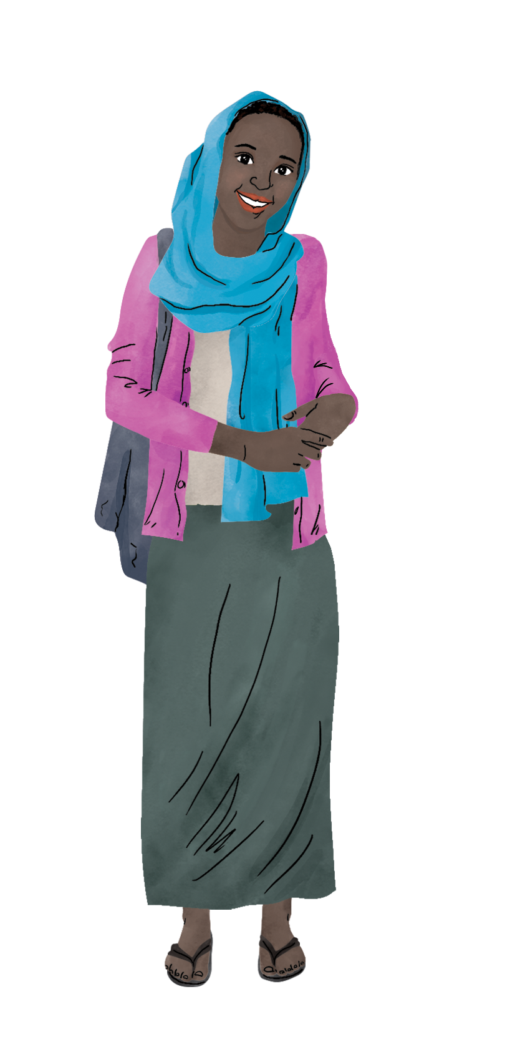
1. Develop a role description.
A role description should outline:
  The knowledge, skills, and attributes you are looking for in an Ambassador.
  A minimum package of activities Ambassadors will need to undertake.
  The range of activities that Ambassadors may undertake.

Slide 15
Ambassador Activities
The range of activities that Ambassadors may undertake include:
Sharing information with their peers and communities about HIV and oral PrEP.
Connecting their peers to sexual and reproductive health services, including HIV counselling and testing, oral PrEP services for HIV prevention, and HIV treatment services.
Providing peer support to AGYW.
Raising awareness and advocating for oral PrEP as an HIV prevention option for AGYW.
Engaging with Ministry of Health officials and oral PrEP providers to advocate for HIV prevention services that meet the needs of AGYW.
Training other AGYW to become HIV Prevention Ambassadors.

Slide 16

QUESTION FOR TRAINERS
Are there any other activities you would like your Ambassadors to carry out (i.e., DREAMS-specific activities) that have not been mentioned?
Notes:
Pause and reflect. Ask participants to respond verbally to the question on the slide.

Slide 17

2. Develop a process for selecting HIV Prevention Ambassadors.
For organizations or programs that are not already working with a group of AGYW, a key component of facilitator preparation is developing a process for selecting HIV Prevention Ambassadors.

Slide 18

FACILITATOR REFLECTION
What has been/might be the process for selecting AGYW to be trained as Ambassadors?
Notes:
Pause and reflect. Ask facilitators to respond verbally to the question on the slide.

Slide 19

3. Develop a support plan.
Support for Ambassadors may include:
  Checking in with Ambassadors regularly.
  Providing Ambassadors with information about local, youth-friendly services, including
  health, social, and legal services.
  Offering ongoing support to process
  emotionally challenging aspects of their roles.
  Helping Ambassadors to develop their own support networks.

Slide 20
3. Develop a support plan (cont.).
Support for Ambassadors may include:
  Facilitating community engagement activities with community leaders, health care providers, parents, and partners to lay the groundwork for activities.
  Training Ambassadors in procedures for responding to critical incidents.
  Recognizing and rewarding their work.
  Providing opportunities for professional development.
  Providing logistical support, including resources, equipment, and materials.

Slide 21
QUESTION FOR TRAINERS
Have you thought about how you will support Ambassadors once trained? If so, kindly tell us how.
If not, this needs to be done prior to training.
Notes:
Pause and reflect. Ask participants to respond verbally to the question on the slide.

Slide 22
Training
Preparation

Slide 23

Training Preparation
Read the entire package before beginning the training.
Review the useful resources listed at the end of each topic.
Prepare specific information about
your location and context.
Prepare copies of a local referral
directory or created one using the
Local Referral Directory Template.

Slide 24
Training Preparation (cont.)
Consider bringing in a guest speaker or co-facilitator.
Prepare the materials needed for the training.
Prepare name games and energizers.
Prepare a graduation certificate.
Review the key terms.
Read the Facilitation Tips.

Slide 25
Logistical Considerations
Aim for 10 to 20 participants per workshop.
Think about your venue(s).
Consider what ongoing support or compensation will be available to Ambassadors post-training.
Consider professional and personal development opportunities Ambassadors will have access to.
Being an HIV Prevention Ambassador may put some AGYW at risk of stigma, marginalization, or even violence; what support is available?

Slide 26
BREAK
Notes:
Take a break. Encourage participants to stretch, use the restroom, or grab some water or a snack. Depending on time, plan for a 10-minute break.

Slide 27
Ambassador
Skills
Notes:
This section covers Ambassador Skills, with specific focus on peer support skills and boundary setting and self-care.

Slide 28
Peer
Support
Skills

Slide 29

Notes:
Hover over the slide and click play to view the video. Ensure that audio is selected.

Slide 30
QUESTION FOR TRAINERS
After watching the video on Peer Support Skills, what questions do you have?
Notes:
Pause and reflect. Ask participants to respond verbally to the question on the slide.

Slide 31
Boundary
Setting &
Self-Care

Slide 32


Compassion Fatigue
Listening to peers’ painful and traumatic experiences – such as experiencing violence, being diagnosed with HIV, or suffering stigma and discrimination – can have an impact on an Ambassador’s well-being and lead to compassion fatigue and vicarious trauma.
Compassion Fatigue refers to the experience of feeling emotionally and physically exhausted as a result of helping others and being exposed to their pain. These feelings build over time and we may not be aware of them until we feel overwhelmed.

Slide 33

Compassion Fatigue (cont.)
Someone who is experiencing compassion fatigue may:
  Feel tired, stressed, and overwhelmed.
  Feel irritable and short-tempered.
  Have trouble finding joy and happiness in life.
  Feel emotional, down, or depressed.

Slide 34
Vicarious Trauma
Vicarious Trauma refers to experiencing trauma symptoms as a result of being personally affected by other people’s trauma.
If we are exposed to too many traumatic experiences, we may start to have an unbalanced view of the world.
  This can result in experiencing similar symptoms to someone who has directly experienced trauma.
    The feeling will most likely build up over time, rather than happen as a result of being exposed to a single person’s trauma.

Slide 35
Vicarious Trauma (cont.)
Someone who is experiencing vicarious trauma may:
  Experience recurring thoughts about other people’s experiences.
  Experience unwanted images in their mind of other people’s traumatic experiences.
  Feel deep anger or sadness at how unfair the world is.
  Feel hopeless or helpless.
  Lose sight of positive things in the world.

Slide 36
Important Notes
Ambassadors may be at high risk of compassion fatigue and vicarious trauma because they will be regularly exposed to the traumatic experiences of their peers and may have had similar experiences.
It is difficult for Ambassadors to separate themselves from what they hear because they will likely share the same background and community as their peers.
Additionally, Ambassadors might have less structured support systems in place in formal support roles, so they may not have anyone to turn to when they experience difficulties.

Slide 37
QUESTION FOR TRAINERS
What questions do you have about these concepts: compassion fatigue and vicarious trauma?
Notes:
Pause and reflect. Ask participants to respond verbally to the question on the slide.

Slide 38

How can Ambassadors protect themselves?
Ambassadors can establish boundaries to limit the personal impact of their work.
Ambassadors can listen to their bodies, thoughts, and feelings so they can respond to their needs.
Ambassadors can practice self-care.

Slide 39
Boundaries
It is important for professionals in caring roles – such as counsellors and healthcare providers – to have strict boundaries. This is because:
  Boundaries help protect them from inappropriate relationships.
  Professionals need personal time so they can focus on their own needs.
Boundaries are guidelines that define what is and is not okay in any relationship, even though we do not necessarily think or talk about them.

Slide 40

Boundaries (cont.)
If Ambassadors do not set boundaries, they are at risk of developing compassion fatigue and vicarious trauma.

Slide 41
Boundaries (cont.)
Ambassadors can use a range of strategies to establish and communicate boundaries, including:
  Communicating when they are working as Ambassadors and when they are not. This may include wearing a badge or restricting their role to certain locations or times.
  Using a different sim card or social media account for their work as Ambassadors.
  Being clear with peers about what their role is and is not.

Slide 42
Self-Care
Self-Care is simply about taking care of ourselves and prioritizing our own needs. Practicing self-care means listening to our bodies, thoughts, and feelings, which allows us to identify our needs.
The earlier we identify and respond to our needs, the easier it is to prevent ongoing bad thoughts, compassion fatigue, and vicarious trauma.
There is no right or wrong way to practice self-care.
  Different people have different needs, so it is important to choose what works for you.

Slide 43
Self-Care (cont.)
Some strategies that prevent or reduce the impact of compassion fatigue and vicarious trauma are:
Being kind and compassionate to yourself
Taking care of your physical needs
Doing something you enjoy
Take a moment for yourself
Sharing how you are feeling
Connecting with your spiritual self or value systems

Slide 44
QUESTION FOR TRAINERS
How many of you have heard of boundary setting and/or self-care? (Use the thumbs up and thumbs down buttons to answer.)
Do you think these concepts will come easily to Ambassadors or will they be a challenge?
Notes:
Pause and reflect. Ask participants to respond verbally to the question on the slide.

Slide 45
Activity:
Case Study
Notes:
Read the case study on the following slide out loud. Decide if the case study activity should be completed in a full group or in breakout rooms.
Suggestion: If you have more than 10 participants, consider breakout rooms. If using breakout rooms, make sure to include a facilitator in each room.

Slide 46
Case Study
Has Natalie shared any confidential information with Michelle? If so, what?
How would Michelle know that this information is confidential?
How can Michelle empower and support Natalie?
Does Michelle need to set boundaries with Natalie? Why, or why not?
What are some strategies that Michelle could use to establish and communicate her boundaries to her peers?
Does Michelle need to do anything to take care of her own emotional well-being? Why, or why not?
Michelle is an HIV Ambassador and Natalie is a young woman in her community with whom she regularly meets. Natalie previously disclosed to Michelle that she has multiple partners, and sometimes receives gifts or small amounts of money from one partner who is older than her.
A few months ago, Natalie decided to start using PrEP as a result of her conversations with Michelle. However, Natalie is having a hard time remembering to take PrEP every day and is afraid that one of her partners will see her. She is considering stopping her PrEP use altogether.
Michelle thinks it is important to support Natalie to continue to use PrEP since she is at risk of HIV infection — but Michelle is frustrated, because even when they make appointments to meet, Natalie is often late and sometimes just doesn’t show up.
Notes:
Either in a full group or in breakout rooms, encourage participants to answer the prompts verbally and discuss.

Slide 47
Homework

Slide 48
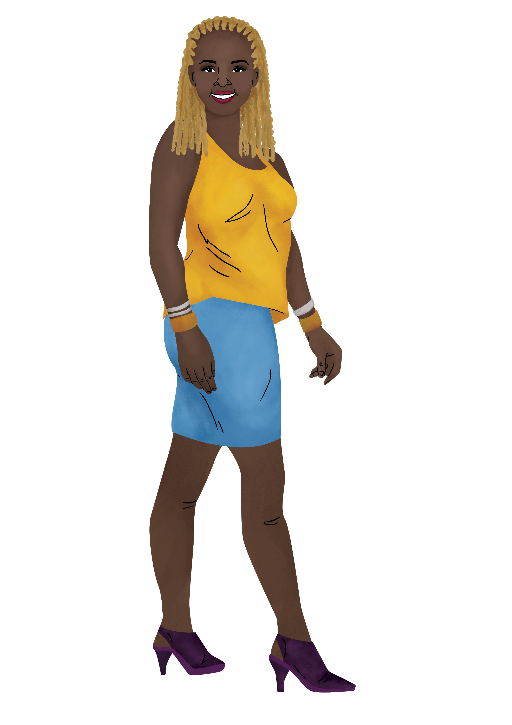
Homework
Assignment | Details
Reflection | Q&A Box Please reflect on the first day of the training. What questions do you have thus far? Submit at least one question to the anonymous Q&A box.
Notes:
Add a link or other mechanism that allows participants to ask questions prior to Day 2.

Slide 49
Day 1
Mentorship
Teams
Notes:
Begin the Day 1 Mentorship Team activities by opening and assigning breakout rooms in Zoom. Instruct mentors to follow the instructions provided in the Mentors’ Activity Guide slide deck.

Slide 50
Acknowledgments
This resource is made possible by the generous support of the American people through the U.S. President's Emergency Plan for AIDS Relief (PEPFAR) and the U.S. Agency for International Development (USAID) and through the terms of cooperative agreements 7200AA19CA00002 and 7200AA19CA00003. The contents are the responsibility of the EpiC project and the RISE project and do not necessarily reflect the views of PEPFAR, USAID, or the U.S. Government.
Suggested Citation:
Weber A, Mamvuto T, Nhamo D, Regeru RN, Jeckonia P, Kiruki M, Mireku M, Bishopp C, Moreau L, Tutegyereize L, Makufa C, Plourde K, Shilomboleni M, Neliwa P, Murungu J. HIV prevention ambassador trainers’ workshop: How to engage adolescent girls and young women as advocates in their communities. Washington, DC: Collaboration for HIV Prevention Options to Control the Epidemic (CHOICE); 2021.

Slide 51
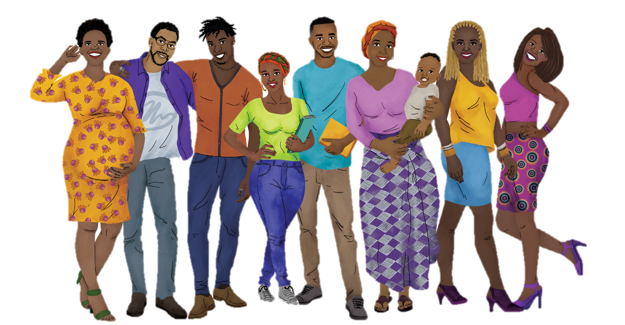
Thank You

Slide 52
DAY
02
HIV Prevention Ambassador Trainers’ Workshop:
HOW TO ENGAGE ADOLESCENT GIRLS AND YOUNG WOMEN
AS ADVOCATES IN THEIR COMMUNITIES
VIRTUAL TRAINING OF TRAINERS
DAY OF THE WEEK | DD Month YYYY
Notes:
Add the date of Day 2 on this slide.

Slide 53
Today’s Facilitators
Name
Title
Organization, Country
Name
Title
Organization, Country
Name
Title
Organization, Country
Notes:
Right-click on each circle and select Change Graphic. Then, select From a File. Use this process to upload photos of each designated facilitator.

Slide 54
Day 2 Agenda
Time | Session | Facilitator
10 minutes | Warm-Up | NAME
20 minutes | Activity: Mentor Panel | NAME
30 minutes | Foundational Knowledge | NAME
20 minutes | Foundational Knowledge | NAME
10 minutes | BREAK
20 minutes | Foundational Knowledge | NAME
10 minutes | Homework | NAME
30 minutes | Activity: Mentorship Teams | ALL MENTORS
Notes:
Add in the appropriate details, including timing of sessions and designated facilitators.

Slide 55
Icebreaker

Slide 56
How-To Annotate
At the top of your Zoom screen, choose View Options, then Annotate.
Throughout this training, we will use the Stamp and Text features.
These are the Stamp icons you can choose from.

Slide 57

What is your favorite sport to play?
Notes:
Annotation: Text

Slide 58
Mentor
Panel

Slide 59

NAME
Country
NAME
Country
NAME
Country
Notes:
Begin the mentor panel. Share the pre-submitted questions with designated mentors and ask them to respond verbally based on their own experiences with HIV Prevention Ambassadors. Encourage participants to ask follow-up questions.
Right-click on each circle and select Change Graphic. Then, select From a File. Use this process to upload photos of each designated expert.

Slide 60
Foundational
Knowledge
Notes:
This section covers Foundational Knowledge, with specific focus on human rights and tips for working through the Ambassador activities presented in the training package sections on the basics of HIV and AIDS and biological vulnerability.

Slide 61
Human
Rights

Slide 62
Pop Quiz!
As human beings, we all share basic rights. Everyone is entitled to these rights, regardless of whom they are or where they live. The international community agreed to a set of rights, listed in the Universal Declaration of Human Rights, in 1948. How many rights does the Declaration include?
    36
    12
    30
ADD YOUR ANSWER TO THE CHAT BOX!

Slide 63
QUESTION FOR TRAINERS
Which rights from the Declaration are specifically mentioned in the HIV Prevention Ambassador Training Package?
Notes:
Pause and reflect. Ask participants to respond verbally to the question on the slide.

Slide 64
Pop Quiz!
The Declaration acknowledges that rights come with duties. The last two points state that…
    Everybody has a duty to protect the rights and freedoms of other people AND nobody has the right to violate the rights or freedom of others.
    Everybody has a duty to protect the rights and freedoms of other people AND governments can violate the rights or freedom of one group to protect the rights and freedom of another group.
    Only those with special privileges can protect the rights and freedoms of other people AND nobody has the right to violate the rights or freedom of others.
ADD YOUR ANSWER TO THE CHAT BOX!

Slide 65
QUESTION FOR TRAINERS
What are sexual and reproductive health rights?
Notes:
Pause and reflect. Ask participants to respond verbally to the question on the slide.

Slide 66
HIV & AIDS
The Basics
Notes:
The following “Expert Advice” slides present specific tips to consider when conducting various activities with HIV Prevention Ambassadors. It is important that training participants read through the entire training package and toolkit prior to the start of the training, so they come to this session with a basic understanding of each activity.

Slide 67

Vote With Your Feet
Tips from experience:
  For statements that are true…
    Have someone from the group who correctly identified the statement as true explain why it is correct.
  For statements that are false…
    Explain why they are incorrect.

Slide 68

Vote With Your Feet (cont.)
Tips from experience:
  Encourage questions.
  Do not be afraid to admit if there is something you do not know for sure.
    Consult with an expert and return with an answer.

Slide 69

Correcting Myths
Tips from experience:
  Consider having each group do a
  role-play activity or write a script, as opposed to creating a poster.

Slide 70
Reflection Circle
Tips from experience:
  Encourage all participants to share their ideas during the reflection session.
    To prevent one participant from dominating the conversation, you could ask each person to share what they have learned.
    If time is not on your side, allocate specific questions to specific participants.

Slide 71

Reflection Circle (cont.)
Tips from experience:
  To overcome shyness, this exercise can be done in pairs. Pairs can discuss the reflection questions for a few minutes, and then one member can present to the larger group without attributing responses to a specific individual.
    If time is not on your side, allocate specific questions to specific pairs.

Slide 72
Biological
Vulnerability

Slide 73
QUESTION FOR TRAINERS
The HIV Prevention Ambassador Training Package recommends using the term vulnerability instead of risk. What do you think of this recommendation?
Notes:
Pause and reflect. Ask participants to respond verbally to the question on the slide.

Slide 74
Safer Sex Continuum
Tips from experience:
  Be prepared to answer questions related
  to why one activity is more or less safe than another.
  Before participants begin arranging the sexual activities from “least vulnerable to HIV" to “most vulnerable to HIV"…
    Explain that some activities are at the same level along the continuum (i.e., they are tied). Such activities should be arranged side by side.

Slide 75
Gender Inequality
& Violence
Notes:
This section covers Gender Inequality & Violence, with specific focus on essential knowledge and recommendations for conducting sessions with Ambassadors.

Slide 76
Essential
Knowledge

Slide 77
Key Definitions
Biological Sex
biological characteristics that a person is born with, including sexual and reproductive organs, chromosomes, and hormones (these characteristics are used to classify people as male, female, or intersex)
Gender
social ideas about what traits and behaviors are acceptable for people born with female or male biological characteristics (these ideas often exclude intersex people)
Gender Inequality
a term used to explain the unequal treatment of someone because of their gender, and the unequal distribution of power and resources between women and men

Slide 78
Key Definitions (cont.)
Gender Norms
these are social ideas and attitudes about the way women and men should look and behave
Gender-Based Violence (GBV)
violence is used to reinforce gender-related power differences
Intimate-Partner Violence (IPV)
GBV can occur within or outside of relationships; when GBV occurs inside relationships, it is called intimate partner violence or domestic violence.
IPV includes violence committed by former partners and individuals in dating relationships.

Slide 79
Key Concepts
Gender inequality is driven by gender norms that give men more access to resources (i.e., money), opportunities (i.e., education, employment), and social power (i.e., influence in decision-making).
Gender norms are attitudes, not facts.
Gender norms can harm both men and women.

Slide 80

Key Concepts (cont.)
Gender is not the only factor that influences a person’s access to resources and opportunities.
When people belong to multiple groups that experience inequality, their experiences of discrimination can multiply.
Gender norms are slowly changing around the world.

Slide 81
Gender-Based Violence
Gender inequality and violence against women are strongly connected. This is because:
  The belief that men are naturally strong, dominant, and powerful is used to explain and justify men’s violence against women.
    In some societies, these gender norms are so strong that men are expected to beat their wives.
  Men’s violence against women reinforces inequality.
    Some men use violence as a tool to show and keep their power over women.

Slide 82

Gender-Based Violence (cont.)
GBV can be perpetrated by anyone, although it is usually perpetrated by a person who has more power than the victim (i.e., partners, parents, teachers, religious leaders, or others with authority).
GBV may include one or more of the following types of violence:
  Physical abuse
  Sexual abuse
  Emotional/psychological abuse
  Economic violence

Slide 83
Gender-Based Violence (cont.)
Gender inequality and violence make it harder for AGYW to negotiate safer sex and access the information, resources, and services they need to protect themselves from HIV. This is because:
Gender norms limit women’s sexual power and control.
Gender norms make it more difficult for women to get an education and be financially independent.
Gender norms justify and excuse men’s control over women and violence against women.

Slide 84
Session
Overview

Slide 85
Key Recommendations
Tips from experience:
  When possible, have this session (and
  Responding to Disclosures of Violence) delivered by a GBV professional/expert.
  Ensure that you have enough copies of a local referral directory for each participant.
  Ensure that you have support in place for any participants that disclose personal experience of GBV (whether past or current).

Slide 86

Rules for Boys/Rules for Girls
Tips from experience:
  Throughout this activity, reinforce that
  gender norms do not have to remain as they have been historically.
  Give examples of how gender norms can and do change.

Slide 87

Problem Tree
Tips from experience:
  Ensure that you guide participants
  through this activity, especially as it relates to key gender norms covered in Essential Knowledge and the ways in which norms contribute to GBV and make it harder for AGYW to protect themselves from HIV.
    This activity takes time. Ensure you schedule accordingly.

Slide 88
Reflection Circle
Tips from experience:
    Ensure that the responses provided
    to this question…
      How can you help peers overcome barriers related to gender norms and protect themselves from HIV?
        … are practical and feasible, do not expose them to risk of harm in any way, and do not involve crossing boundaries that should exist between Ambassadors and their peers.

Slide 89
Key Messages
Gender norms give men more freedom and control over their lives and more access to resources, opportunities, and power than women.
Gender norms teach women and men that violence against women and girls is acceptable.
  Men may feel that they will be viewed as less of a man if they do not have control in relationships, and women may feel that violence is a normal.
Violence is used by men to show and keep their power over women.

Slide 90
Key Messages (cont.)
REMEMBER!
Women are never to blame for the violence perpetrated against them. Men make a choice to use violence. We know this is true because many men choose not to be violent, and men who are violent in relationships choose not to be violent at work or in other spaces of their lives.
Everybody has the right to live a life free from violence.
Gender inequality and violence make it harder for AGYW to protect themselves from HIV.
Oral PrEP is an additional way for AGYW to protect themselves from HIV.

Slide 91
BREAK
Notes:
Take a break. Encourage participants to stretch, use the restroom, or grab some water or a snack. Depending on time, plan for a 10-minute break.

Slide 92
Responding
to Disclosures
of Violence
Notes:
This section covers Responding to Disclosures of Violence.

Slide 93
What does it mean to disclose violence?
Violence may have happened recently, in the past, or be ongoing. While some may directly disclose experiences and ask for help, others might disclose violence indirectly by:
  Becoming emotional during conversations about violence.
  Making comments that suggest they want
  to talk without directly asking for help.
  Using hypotheticals to ask for advice.
  Asking for advice on behalf of a friend.
Disclosure, in this context, is when someone reveals that they have experienced or are experiencing violence.

Slide 94
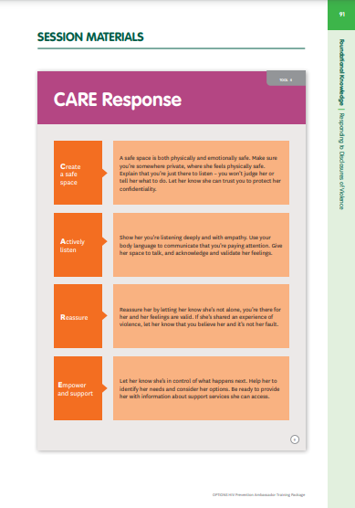
Supporting Ambassadors’ Response
The CARE response was developed to guide Ambassadors to respond to disclosures of violence from their peers.
  It is based on the internationally recognized survivor-centered approach for working with
  survivors of violence.

Slide 95
Survivor-Centered Approach
The survivor-centered approach recognizes that survivors have the right to:
Be treated with respect and dignity.
Receive equal and fair treatment regardless of their age, gender, race, religion, nationality, ethnicity or any other characteristic.
Make their own decisions about what they need and how they want to act.
Choose whom they will or will not share their experience with, and what information they want to be kept confidential.

Slide 96




The CARE Response

Slide 97
The CARE Response (cont.)
What does it mean for a space to be safe?
What might peers need from a space for them to feel safe to talk about their experience with violence?
Demonstrate how an Ambassador can create a safe space for a peer who wants to talk to them about their experience of violence.

Slide 98
The CARE Response (cont.)
What is active listening? How can we achieve it?
Imagine you are struggling with something, and you want to talk to someone about your feelings.
  What qualities would you look for when choosing someone to talk to?
  How would an Ambassador demonstrate active listening to a peer?

Slide 99
The CARE Response (cont.)
It is common for those who have experienced violence to be fearful that people will think they are lying. Some may even question or doubt themselves. This shame and fear can stop them from seeking help.
Reassuring their peers that they believe them, that it is not their fault, and that their feelings are valid is one of the most valuable things that Ambassadors can do. It can be a great relief to someone who has experienced violence to know that someone believes them.
How would an Ambassador reassure a peer who is disclosing their experience with violence?

Slide 100
The CARE Response (cont.)
Violence is about power and control. Survivors of violence commonly feel powerless. Step 4 is about encouraging peers to identify what they need and connecting them with support services.
Name one thing an Ambassador can do to empower and support their peers to identify what they need and how they might seek further support.
List existing organizations that offer youth-friendly services for victims of violence.

Slide 101
Homework

Slide 102
Homework
Assignment | Details
Assignments | Learning Design & Delivery Complete Trainer Skills Inventory. Read Managing Challenging Participants and answer prompts. Review Adult Learning Infographic.

Slide 103
Day 2
Mentorship
Teams
Notes:
Begin the Day 2 Mentorship Team activities by opening and assigning breakout rooms in Zoom. Instruct mentors to follow the instructions provided in the Mentors’ Activity Guide slide deck.

Slide 104
Acknowledgments
This resource is made possible by the generous support of the American people through the U.S. President's Emergency Plan for AIDS Relief (PEPFAR) and the U.S. Agency for International Development (USAID) and through the terms of cooperative agreements 7200AA19CA00002 and 7200AA19CA00003. The contents are the responsibility of the EpiC project and the RISE project and do not necessarily reflect the views of PEPFAR, USAID, or the U.S. Government.
Suggested Citation:
Weber A, Mamvuto T, Nhamo D, Regeru RN, Jeckonia P, Kiruki M, Mireku M, Bishopp C, Moreau L, Tutegyereize L, Makufa C, Plourde K, Shilomboleni M, Neliwa P, Murungu J. HIV prevention ambassador trainers’ workshop: How to engage adolescent girls and young women as advocates in their communities. Washington, DC: Collaboration for HIV Prevention Options to Control the Epidemic (CHOICE); 2021.

Slide 105
Thank You

Slide 106
DAY
03
HIV Prevention Ambassador Trainers’ Workshop:
HOW TO ENGAGE ADOLESCENT GIRLS AND YOUNG WOMEN
AS ADVOCATES IN THEIR COMMUNITIES
VIRTUAL TRAINING OF TRAINERS
DAY OF THE WEEK | DD Month YYYY
Notes:
Add the date of Day 3 on this slide.

Slide 107
Today’s Facilitators
Name
Title
Organization, Country
Name
Title
Organization, Country
Name
Title
Organization, Country
Notes:
Right-click on each circle and select Change Graphic. Then, select From a File. Use this process to upload photos of each designated facilitator.

Slide 108
Day 3 Objectives & Agenda
Today’s session will help you to:
  Deliver a participatory training.
  Identify strengths to leverage and areas for development in training design and delivery.
Time | Session | Facilitator
10 minutes | Warm-Up | NAME
80 minutes | Learning Design & Delivery | NAME
10 minutes | BREAK
5 minutes | Homework | NAME
45 minutes | Activity: Mentorship Teams | ALL MENTORS
Notes:
Add in the appropriate details, including timing of sessions and designated facilitators.

Slide 109
Learning
Design &
Delivery
Notes:
This section covers Learning Design & Delivery.
Note: This section is unique to this training. It does not appear in the training package and toolkit. Share with participants that having an understanding of the basic concepts of learning design and delivery is helpful when training Ambassadors with different learning styles.

Slide 110

So, you want to learn how to sail…
Which would you do first?
Watch people sail.
Watch instructional videos with practice questions.
Practice with an instructor.
Start sailing a boat!

Slide 111
VOTE WITH YOUR FEET
I take time to reflect before speaking.
My thoughts and ideas get clearer as I speak about them.
Notes:
Annotation: Stamp

Slide 112
VOTE WITH YOUR FEET
I prefer for someone else to answer questions about sex.
Ask me anything about sex!
Notes:
Annotation: Stamp

Slide 113
VOTE WITH YOUR FEET
When plans unexpectedly change, I adapt swiftly.
When plans unexpectedly change, I need time to process.
Notes:
Annotation: Stamp

Slide 114
VOTE WITH YOUR FEET
When receiving feedback, I tend to take things personally.
I can separate my feelings from constructive feedback.
Notes:
Annotation: Stamp

Slide 115
What type of learner are you?
OBSERVER
ANALYZER
EXPERIENCER
INNOVATOR
Notes:
Ask participants to share in the chat box: What type of learner do you think you are?

Slide 116

Preferred Learning Styles
An observer learns by observing, reading, watching, or taking a field trip.
An analyzer learns by analyzing, problem solving, or looking at case studies.
An experiencer learns by experiencing or doing, practicing, or conducting role plays.
An innovator learns by discovery, creating, experimenting, or prototyping.

Slide 117
In this session, we will:
Assess knowledge of learning design principles by playing a review game.
Assess learning design principles using a case study.
Apply learning design and delivery steps and practices via a participatory lecture.

Slide 118
Learning Principles
Review
Game

Slide 119

WHO WANTS
TO BE
A MILLIONAIRE

Slide 120
Team Alpha A-K | Team Zed L-Z
Notes:
Split your group of participants into two teams. Explain that Team Alpha consists of participants with last names beginning with letters A-K, and Team Zed consists of participants with last name beginning with letters L-Z. Ask participants to note to themselves which team they belong to.

Slide 121

Which is NOT a principle of adult learning (andragogy)?
50:50
A: Subjects have relevance
to learner's work/life
B: Learners are a part
of planning
C: Learners have many
demands on their time
D: Learning should be
problem-centered
Notes:
Ask a member of Team Alpha the question. Note that if they are unsure of the answer, they can utilize one, two, or three of following options:
50:50: Ask you, the facilitator, to verbally remove two incorrect answers.
PHONE A FRIEND: Ask a fellow team member for their opinion.
ASK THE AUDIENCE: Ask all members of their team for their opinion.
Once an answer is selected, share the correct response.

Slide 122
Learning design and delivery should focus on...
50:50
B: Having learners get
high post-test scores
A: Getting learners engaged
C: Getting expert input
D: Doing over knowing
Notes:
Ask a member of Team Zed the question. Note that if they are unsure of the answer, they can utilize one, two, or three of following options:
50:50: Ask you, the facilitator, to verbally remove two incorrect answers.
PHONE A FRIEND: Ask a fellow team member for their opinion.
ASK THE AUDIENCE: Ask all members of their team for their opinion.
Once an answer is selected, share the correct response.

Slide 123
Which of the following is NOT part of the experiential learning cycle?
50:50
A: Lecture
B: Reflect
C: Apply
D: Generalize
Notes:
Ask a member of Team Alpha the question. Note that if they are unsure of the answer, they can utilize one, two, or three of following options:
50:50: Ask you, the facilitator, to verbally remove two incorrect answers.
PHONE A FRIEND: Ask a fellow team member for their opinion.
ASK THE AUDIENCE: Ask all members of their team for their opinion.
Once an answer is selected, share the correct response.

Slide 124
Which is NOT a strategy to use with shy or timid participants?
50:50
A: Ask them an easy,
direct question
B: Stand behind them while
you are talking
C: Talk with them on a
personal basis
D: Ask the person next to them,
then ask them to comment
Notes:
Ask a member of Team Zed the question. Note that if they are unsure of the answer, they can utilize one, two, or three of following options:
50:50: Ask you, the facilitator, to verbally remove two incorrect answers.
PHONE A FRIEND: Ask a fellow team member for their opinion.
ASK THE AUDIENCE: Ask all members of their team for their opinion.
Once an answer is selected, share the correct response.

Slide 125
Learning Principles
Case Study
Notes:
Read the case study linked on the following slide out loud. Decide if the case study activity should be completed in a full group or in breakout rooms.
Suggestion: If you have more than 10 participants, consider breakout rooms. If using breakout rooms, make sure to include a facilitator in each room.

Slide 126

Breakout Groups
Review this case study about Ben and Martha.
Answer the prompts and discuss.
Assign a group reporter.
Ben
Martha
Notes:
If using breakout rooms, assign a group reporter. Group reporters will be tasked with sharing what was discussed within their breakout rooms with the full group.

Slide 127
Participatory Lecture

Slide 128

Assumptions
About | Pedagogical | Andragogical
Concept of the learner | Dependent personality | Increasingly self-directed
Role of learner’s experience | To be built on more than used as a resource | A rich resource for learning by self and others
Readiness to learn | Uniform by age level and curriculum | Develops from life tasks and problems
Orientation to learning | Subject-centered | Task- or problem-centered
Motivation | By external rewards and punishment | By internal incentives and curiosity
Theories
Instructor-led
Experiences
Self-directed
Notes:
Source: Knowles, M.S. (1992). Applying principles of adult learning in conference presentations. Adult Learning, 4(1), p. 12.

Slide 129
ADDIE Model
Analyze
Design
Develop
Implement
Evaluate
Notes:
Walk through the components of the ADDIE model.
Suggestion: As a facilitator, it is important to familiarize yourself with this model before beginning this session.

Slide 130
A IS FOR ANALYZE
WHERE YOU NEED TO BE
Looks at…
Who the learner is
The gap in performance
The learning goal
Essential skills and knowledge
90% of the solution is identifying the problem.
SKILLS
NEEDED
TO GET
WHERE
YOU’RE
GOING
WHERE YOU ARE

Slide 131
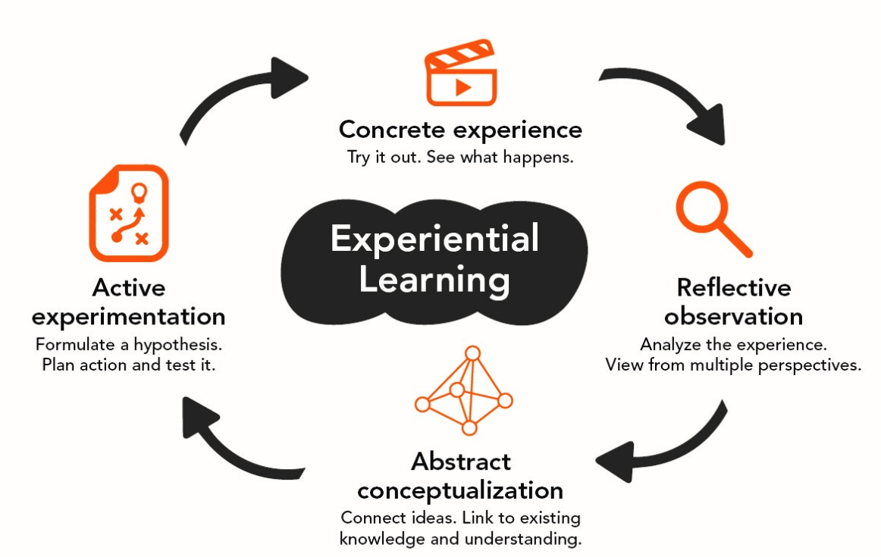
D IS FOR DESIGN
Experience
Looks at…
Learning objectives that are performance-based
How to assess learning
Overall strategy or map for the program
How are you going to get there if you don’t know where you’re going?
Reflect
Apply
Generalize

Slide 132
“DO” OVER “KNOW”
Lead a DREAMS Ambassador Training activity…
during a teach back/practice session…
according to the skills outlined on the Trainer Skills Inventory.
Performance—What the learner needs to be able to do or know
Condition—What type of learning method or activity will be used
Criteria—To what standard they will perform

Slide 133
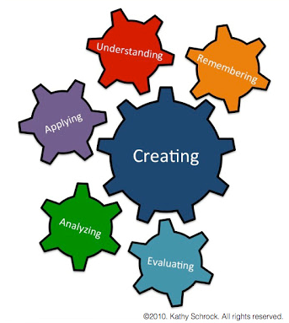
Bloom’s Taxonomy
D IS ALSO FOR
DEVELOP
Looks at…
Methods to maximize learner engagement and learning outcomes
Preparation for implementation

Slide 134
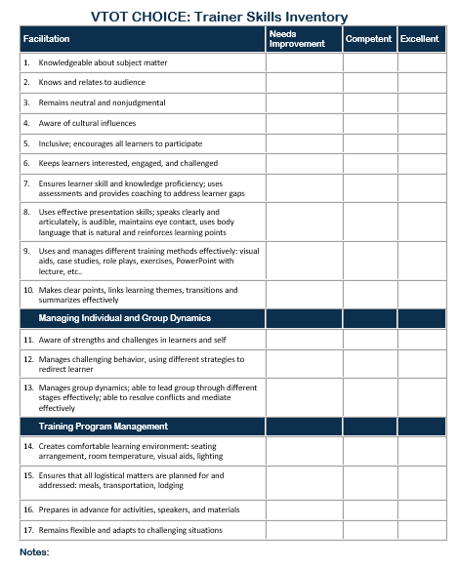
Preparing for launch, ensuring the transfer of learning, leading the learning experience, and monitoring logistics
I IS FOR IMPLEMENT

Slide 135
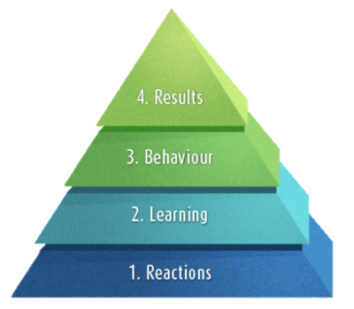
Assessing the effectiveness of the learning intervention and applying lessons learned
Kirkpatrick’s 4 Levels
E IS FOR EVALUATE

Slide 136
Facilitation
Tips

Slide 137
Facilitation Tips
Read the training manual in advance to make sure you have the knowledge you need to facilitate the sessions.
Reflect on your values, attitudes, and beliefs and how they might affect your work.
Create a participatory learning environment.

Slide 138
Facilitation Tips (cont.)
Create a safe space so participants feel comfortable to participate openly and honestly.
Be inclusive and ensure that everyone can participate equally.
Encourage open and honest communication about sex.

Slide 139

Facilitation Tips (cont.)
Prepare to support participants through personal and difficult topics.
Use active listening to validate participant contributions.
Ask questions to encourage deeper thinking and challenge assumptions.
Debrief with colleagues.

Slide 140
BREAK
Notes:
Take a break. Encourage participants to stretch, use the restroom, or grab some water or a snack. Depending on time, plan for a 10-minute break.

Slide 141
Homework

Slide 142
Homework
Assignment | Details
Reflection | Q&A Box Please reflect on the training thus far. What questions do you have? Submit at least one question to the anonymous Q&A box.
Debrief | Mentorship teams should be prepared to report back on their Day 3 activity findings.
Notes:
Add a link or other mechanism that allows participants to ask questions prior to Day 4.

Slide 143
Day 3
Mentorship
Teams
Notes:
Begin the Day 3 Mentorship Team activities by opening and assigning breakout rooms in Zoom. Instruct mentors to follow the instructions provided in the Mentors’ Activity Guide slide deck.

Slide 144
Acknowledgments
This resource is made possible by the generous support of the American people through the U.S. President's Emergency Plan for AIDS Relief (PEPFAR) and the U.S. Agency for International Development (USAID) and through the terms of cooperative agreements 7200AA19CA00002 and 7200AA19CA00003. The contents are the responsibility of the EpiC project and the RISE project and do not necessarily reflect the views of PEPFAR, USAID, or the U.S. Government.
Suggested Citation:
Weber A, Mamvuto T, Nhamo D, Regeru RN, Jeckonia P, Kiruki M, Mireku M, Bishopp C, Moreau L, Tutegyereize L, Makufa C, Plourde K, Shilomboleni M, Neliwa P, Murungu J. HIV prevention ambassador trainers’ workshop: How to engage adolescent girls and young women as advocates in their communities. Washington, DC: Collaboration for HIV Prevention Options to Control the Epidemic (CHOICE); 2021.

Slide 145
Thank You

Slide 146
DAY
04
HIV Prevention Ambassador Trainers’ Workshop:
HOW TO ENGAGE ADOLESCENT GIRLS AND YOUNG WOMEN
AS ADVOCATES IN THEIR COMMUNITIES
VIRTUAL TRAINING OF TRAINERS
DAY OF THE WEEK | DD Month YYYY
Notes:
Add the date of Day 4 on this slide.

Slide 147
Today’s Facilitators
Name
Title
Organization, Country
Name
Title
Organization, Country
Name
Title
Organization, Country
Notes:
Right-click on each circle and select Change Graphic. Then, select From a File. Use this process to upload photos of each designated facilitator.

Slide 148
Day 4 Agenda
Time | Session | Facilitator
10 minutes | Warm-Up | NAME
20 minutes | Activity: Mentor Panel | NAMES
45 minutes | Activity: Challenging Situations & Facilitation Debrief | ALL MENTORS
10 minutes | Role-Play Demonstration/Teach-Back | NAME
5 minutes | Homework | NAME
60 minutes | Activity: Mentorship Teams | ALL MENTORS
Notes:
Add in the appropriate details, including timing of sessions and designated facilitators.

Slide 149
Icebreakers

Slide 150
How-To Annotate
At the top of your Zoom screen, choose View Options, then Annotate.
Throughout this training, we will use the Stamp and Text features.
These are the Stamp icons you can choose from.

Slide 151
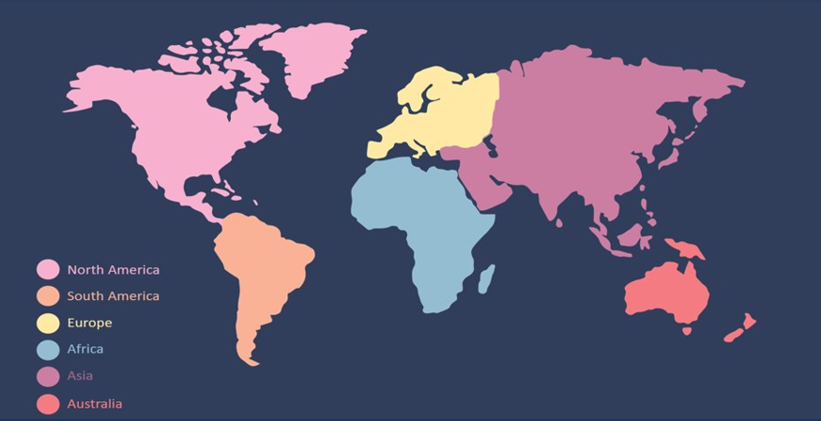
Where would you go on your dream vacation?
Notes:
Annotation: Stamp

Slide 152

Which season of the year do you prefer?
Notes:
Annotation: Stamp

Slide 153
Mentor
Panel

Slide 154
NAME
Country
NAME
Country
NAME
Country
Notes:
Begin the mentor panel. Share the pre-submitted questions with designated mentors and ask them to respond verbally based on their own experiences with HIV Prevention Ambassadors. Encourage participants to ask follow-up questions.
Right-click on each circle and select Change Graphic. Then, select From a File. Use this process to upload photos of each designated expert.

Slide 155
Challenging
Situations
& Facilitation
Notes:
This section covers Challenging Situations & Facilitation. Mentorship teams will share what they discussed in the previous day’s activity.
Note: This section is unique to this training. It does not appear in the training package and toolkit. Share with participants that knowing how to respond to challenging situations is important when training Ambassadors.

Slide 156

Challenging Situations Debrief
Team 1: Social/Group Dynamics
Team 2: Social/Group Dynamics
Team 3: Social/Group Dynamics
Team 4: Participant Support
Team 5: Participant Support
Power
Dynamics
Personal
Conflicts
Personal
Beliefs
Competing
Priorities
Notes:
Allow time for each team to debrief, beginning with Team 1.

Slide 157
Challenging Situations Debrief
Team 1: Social/Group Dynamics
Team 2: Social/Group Dynamics
Team 3: Social/Group Dynamics
Team 4: Participant Support
Team 5: Participant Support
Power
Dynamics
Personal
Conflicts
Personal
Beliefs
Competing
Priorities

Slide 158
Challenging Situations Debrief
Team 1: Social/Group Dynamics
Team 2: Social/Group Dynamics
Team 3: Social/Group Dynamics
Team 4: Participant Support
Team 5: Participant Support
Power
Dynamics
Personal
Conflicts
Personal
Beliefs
Competing
Priorities

Slide 159

Challenging Situations Debrief
Team 1: Social/Group Dynamics
Team 2: Social/Group Dynamics
Team 3: Social/Group Dynamics
Team 4: Participant Support
Team 5: Participant Support
HIV+
Diagnoses
Trigger
Warnings
COVID-19
Outbreaks
GBV

Slide 160
Challenging Situations Debrief
Team 1: Social/Group Dynamics
Team 2: Social/Group Dynamics
Team 3: Social/Group Dynamics
Team 4: Participant Support
Team 5: Participant Support
HIV+
Diagnoses
Trigger
Warnings
COVID-19
Outbreaks
GBV

Slide 161
Role-Play
Demonstration
Notes:
This section covers Role-Play Demonstrations, an activity that participants will prepare to present on Day 5. On the following slides, share the instructions with participants and answer clarifying questions.

Slide 162
What is a role-play demonstration?
This is a practice session where you lead an activity from the HIV Prevention Ambassador Training Package just as you would with actual Ambassadors.
Ensure that the activity is interactive and that you foster discussion and engagement with the participants.
The rest of the group will act as participants, who are would-be Ambassadors, AGYWs just out of school.

Slide 163
Quick Tips
Keep the demonstration short and concise.
Focus on relatability – your audience should be able to relate to the characters and the themes.
Engage your audience.
Assign different roles to team members.
Summarize key messages from your topic and incorporate them throughout your role-play.

Slide 164
Homework

Slide 165
Homework
Assignment | Details
Demonstration | Mentorship teams should be prepared to lead role-play demonstrations based on their Day 4 activity.
Assignment | Learner Action Plan Fill out the learner action plan template.

Slide 166
Day 4
Mentorship
Teams
Notes:
Begin the Day 4 Mentorship Team activities by opening and assigning breakout rooms in Zoom. Instruct mentors to follow the instructions provided in the Mentors’ Activity Guide slide deck.

Slide 167
Acknowledgments
This resource is made possible by the generous support of the American people through the U.S. President's Emergency Plan for AIDS Relief (PEPFAR) and the U.S. Agency for International Development (USAID) and through the terms of cooperative agreements 7200AA19CA00002 and 7200AA19CA00003. The contents are the responsibility of the EpiC project and the RISE project and do not necessarily reflect the views of PEPFAR, USAID, or the U.S. Government.
Suggested Citation:
Weber A, Mamvuto T, Nhamo D, Regeru RN, Jeckonia P, Kiruki M, Mireku M, Bishopp C, Moreau L, Tutegyereize L, Makufa C, Plourde K, Shilomboleni M, Neliwa P, Murungu J. HIV prevention ambassador trainers’ workshop: How to engage adolescent girls and young women as advocates in their communities. Washington, DC: Collaboration for HIV Prevention Options to Control the Epidemic (CHOICE); 2021.

Slide 168
Thank You

Slide 169
DAY
05
HIV Prevention Ambassador Trainers’ Workshop:
HOW TO ENGAGE ADOLESCENT GIRLS AND YOUNG WOMEN
AS ADVOCATES IN THEIR COMMUNITIES
VIRTUAL TRAINING OF TRAINERS
DAY OF THE WEEK | DD Month YYYY
Notes:
Add the date of Day 5 on this slide.

Slide 170
Today’s Facilitators
Name
Title
Organization, Country
Name
Title
Organization, Country
Name
Title
Organization, Country
Notes:
Right-click on each circle and select Change Graphic. Then, select From a File. Use this process to upload photos of each designated facilitator.

Slide 171
Day 5 Agenda
Time | Session | Facilitator
10 minutes | Warm-Up Group Photo! | NAME
60 minutes | Activity: Mentorship Teams | ALL MENTORS
10 minutes | BREAK
25 minutes | Learner Action Plans | NAME
30 minutes | The Mentorship Network | NAME
15 minutes | Training Conclusion | NAME
Notes:
Add in the appropriate details, including timing of sessions and designated facilitators.

Slide 172

But First…
A (VIRTUAL)
SELFIE!
Notes:
Stop sharing your screen and ask participants to turn on their cameras if bandwidth will allow. Take a screenshot of the group to share after the training.

Slide 173
Day 5
Mentorship
Teams
Notes:
Begin the Day 5 Mentorship Team activities by opening and assigning breakout rooms in Zoom. Instruct mentors to follow the instructions provided in the Mentors’ Activity Guide slide deck.

Slide 174
BREAK
Notes:
Take a break. Encourage participants to stretch, use the restroom, or grab some water or a snack. Depending on time, plan for a 10-minute break.

Slide 175
Learner
Action Plans
Notes:
This section covers Learner Action Plans. Participants were instructed on Day 4 to complete their personalized learner action plan.

Slide 176

Sharpening the saw…
Sharpening the saw means you are preserving and enhancing the greatest asset you have… YOU.
Mind – Read, educate, write, learn new skills
Heart – Build relationships, give and serve, laugh, love
Body – Exercise, eat healthy, sleep and rest, relax
Soul – Meditate, keep a journal, practice gratitude/joy, take in quality media
Notes:
Source: Dr. Stephen R. Covey, The 7 Habits of Highly Effective People

Slide 177
What prevents you from doing this?
Too busy/not enough time
Do not know how to make time
Need to focus on measurable project deliverables
Do not know what resources are available to me
Limited access to resources
My manager does not support these activities
Overwhelmed by potential options – where to start?
Which of these factors can you influence or control?
Notes:
Pause and reflect. Ask participants to respond verbally to the question on the slide.

Slide 178
It’s important to AIM…
Assess
  Review Training Stills Inventory
Identify
  Prioritize skills and knowledge needed
  Determine balance of courses, practice, and coaching needed
Monitor
  Share goals and milestones
  Monitor progress

Slide 179
QUESTION FOR TRAINERS
Share how you will assess, identify, and monitor your progress as an Ambassador trainer using the learner action plan.
Notes:
Pause and reflect. Ask participants to respond verbally to the question on the slide.

Slide 180
The
Mentorship
Network
Notes:
This section covers the Mentorship Network. Share with participants the ways in which they can continue to connect and network with past and current training facilitators, mentors, and participants after the training has concluded.

Slide 181

WhatsApp
Audience
  Your mentorship team, including you and your mentor. Your WhatsApp group should include 11-12 people total.
Purpose
  To connect directly with your team,
  ask quick questions, and stay
  in touch while you and your teammates
  start training.
Notes:
Participants should already be connected to their mentorship teams on WhatsApp. Use this slide to remind participants of this resource.

Slide 182

Mighty Networks
Audience
  All past, present, and future facilitators, mentors, and participants of the training.
Purpose
  Think of the Mighty Networks site as our own
  private Facebook group. Facilitators,
  mentors, and participants alike should
  use it to share resources, start discussions,
  ask for feedback, and seek ongoing
  support.
Notes:
Give participants the opportunity to join our Mighty Networks site. Doing so will grant them access to all past cohorts of training facilitators, mentors, and participants. Think of the Mighty Networks site as a private Facebook group.
Share the link in the chat box: https://hiv-prevention-trainers-network.mn.co/share/Ysx7n9dasWf6cS8l?utm_source=manual

Slide 183
Training
Conclusion

Slide 184
Final Task
Assignment | Details
Survey | Training Evaluation Please complete the training evaluation survey no later than DATE.
Notes:
Add a link or other mechanism that allows participants to assess the training. Your training will be unique to your specific needs, so your training evaluation should also be tailored to outputs that matter most for assessment.

Slide 185
Acknowledgments
This resource is made possible by the generous support of the American people through the U.S. President's Emergency Plan for AIDS Relief (PEPFAR) and the U.S. Agency for International Development (USAID) and through the terms of cooperative agreements 7200AA19CA00002 and 7200AA19CA00003. The contents are the responsibility of the EpiC project and the RISE project and do not necessarily reflect the views of PEPFAR, USAID, or the U.S. Government.
Suggested Citation:
Weber A, Mamvuto T, Nhamo D, Regeru RN, Jeckonia P, Kiruki M, Mireku M, Bishopp C, Moreau L, Tutegyereize L, Makufa C, Plourde K, Shilomboleni M, Neliwa P, Murungu J. HIV prevention ambassador trainers’ workshop: How to engage adolescent girls and young women as advocates in their communities. Washington, DC: Collaboration for HIV Prevention Options to Control the Epidemic (CHOICE); 2021.

Slide 186
Thank You

